Slide 1
Inniskeen Road: July Evening
Patrick Kavanagh

Slide 2
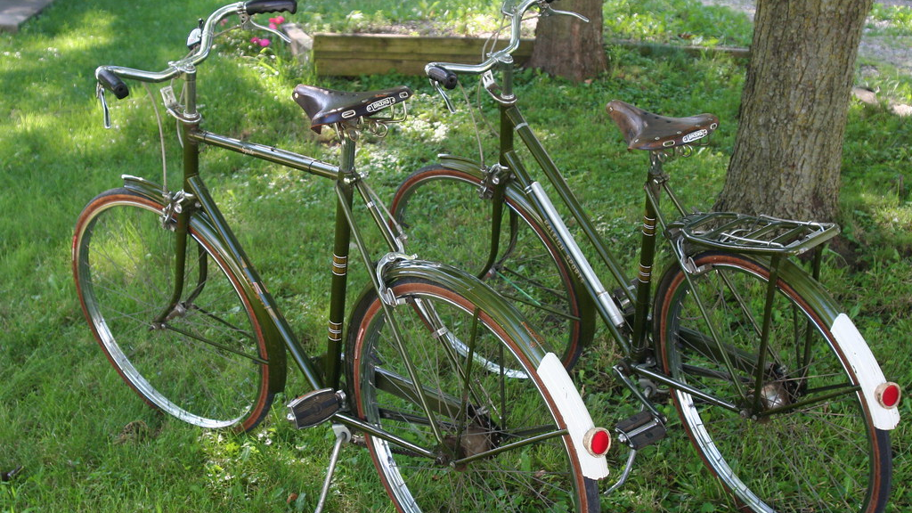
Summary
First published in 1936
First published example of Kavanagh’s realism
Poetry could be written about the local and the ordinary
This is a personal poem – Kavanagh’s own situation – his plight as poet – insider and outsider
Honesty – ‘solemn talk of contemplation’ – distances himself from phoney literary attitudes and posing
Ordinary world – a road, bicycles, a barn dance
Conversational tone – ordinary diction can be used in poetry
This Photo by Unknown Author is licensed under CC BY-NC-ND

Slide 3
Bikes on the Road to Billy Brennan’s Barn, Inniskeen – courtesy of http://www.fisherbelfast.wordpress.com

Slide 4
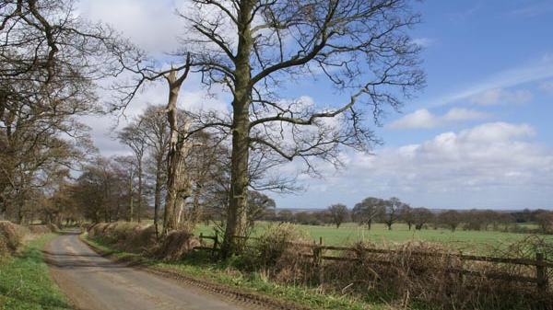
The bicycles go by in twos and threes –
There’s a dance in Billy Brennan’s barn tonight,
And there’s the half-talk code of mysteries
And the wink-and-elbow language of delight.
Half-past eight and there is not a spot
Upon a mile of road, no shadow thrown
That might turn out a man or woman, not
A footfall tapping secrecies of stone.
I have what every poet hates in spite
Of all the solemn talk of contemplation.
Oh, Alexander Selkirk knew the plight
Of being king and government and nation.
A road, a mile of kingdom. I am king
Of banks and stones and every blooming thing.
This Photo by Unknown Author is licensed under CC BY-NC-ND

Slide 5
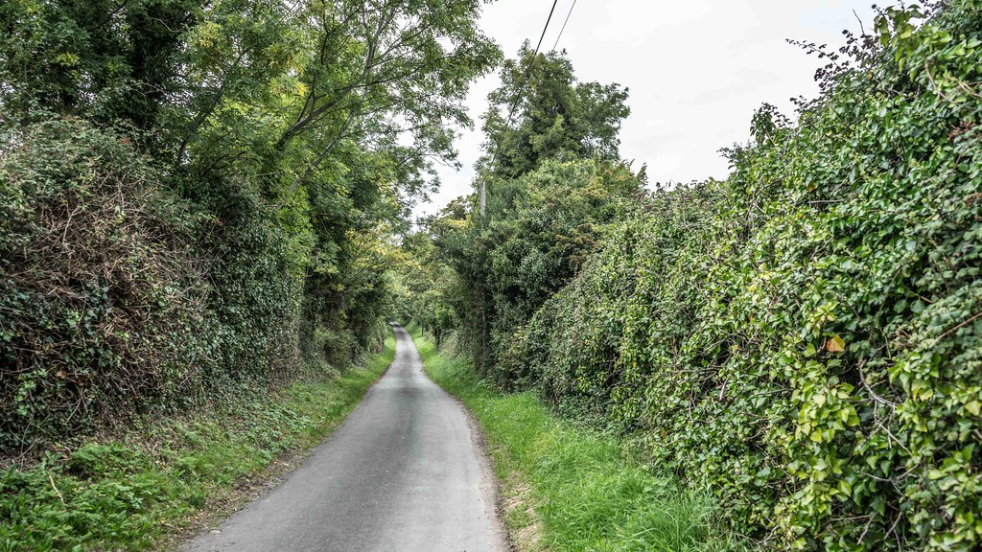
THEME:
This poem is about the isolation of the poet. A poet is different from other people: he is not interested in material matters such as the price of cattle, the progress of crops or the results of football matches.
The poet lives in the world of imagination and because of this he is often considered as an outsider; he is isolated – a loner – he does not fit in to ordinary society. So the price the poet pays for his gift of poetry is the pain of isolation.
This Photo by Unknown Author is licensed under CC BY-SA

Slide 6
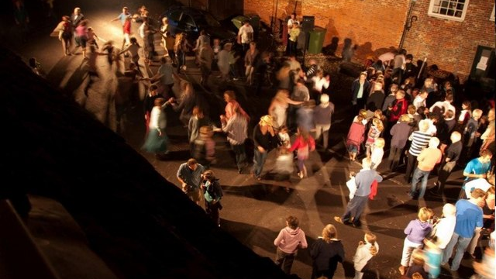
This poem recounts a local barn dance and the whole neighbourhood has gone for an evening’s enjoyment.
Kavanagh has not gone – perhaps for fear of being laughed at.
The tone of the octet (first 8 lines)is thoughtful as well as being bitter.
There is a sense of loneliness in it – ‘and there is not a spot upon a mile of road…’ He feels a palpable sense of being excluded by the other young people’s ‘half-talk code of mysteries’ and by their ‘wink and elbow language of delight’.
This Photo by Unknown Author is licensed under CC BY-SA

Slide 7
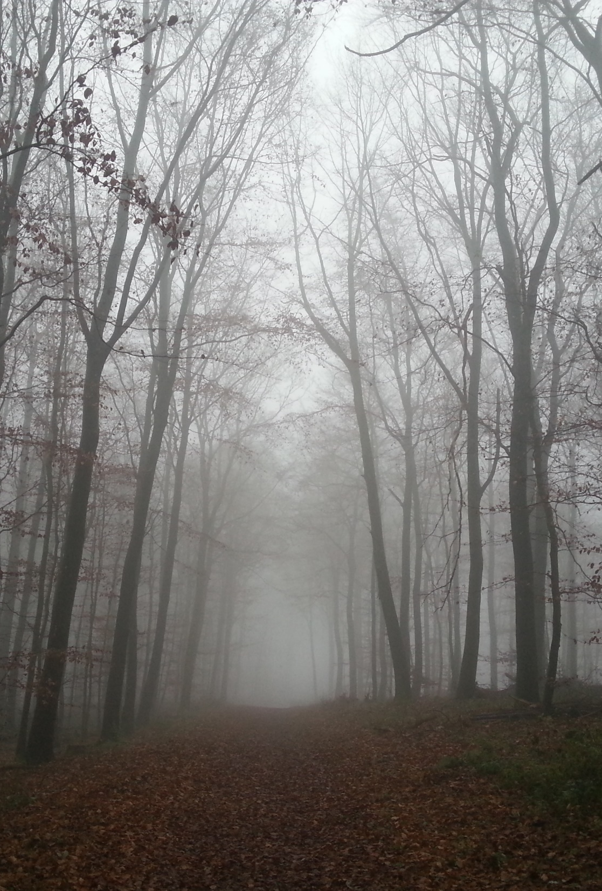
In the sestet (final 6 lines) the tone is again very bitter when he considers his own isolation and compares his lot with that of Alexander Selkirk, the prototype for Daniel Defoe’s Robinson Crusoe – ‘Oh, Alexander Selkirk knew the plight…’.
I can sense the bitterness of the final line: ‘I am king of banks and stones and every blooming (God damned) thing’.
This Photo by Unknown Author is licensed under CC BY-SA

Slide 8
Language
Kavanagh is the poet of ordinary language. He has no place for poetic diction or flowery language. Instead he uses ordinary, colloquial language.
This use of ordinary speech is part of his simplicity; he does not try to impress; he is not looking over his shoulder at the literary critics. Here he is content with himself and with his language: there is a country barn dance in ‘Billy Brennan’s barn’, ‘the bicycles go by in twos and threes’, there is ‘the half talk code of mysteries’ and also he notices ‘the wink and elbow language of delight’, capturing perfectly the closely-knit peasant atmosphere of the local dance.

Slide 9
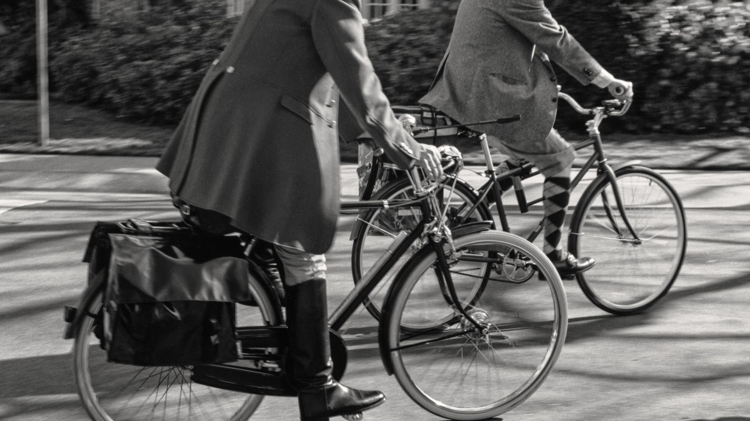
Structure
In the first quatrain (4 lines) Kavanagh focuses on the togetherness, the closely-knit community spirit of the place – the cyclists going along the stony road to the local dance. They are so closely-knit they don’t even have to speak to be understood, they wink, use ‘half-code’, and nudge each other in an excited way – they communicate in code, they gesture and signal each other. This creates a huge obstacle for the reticent, isolated poet.

Slide 10
In the second quatrain the road is deserted. We sense the poet who has probably noticed all the earlier excitement from a safe distance, hidden from view, now is overcome with a sense of isolation and the silence on the roadway is unbearable, ‘not a footfall tapping secrecies of stone’ – he might as well be on a deserted island.
In the sestet Kavanagh further contemplates his own situation and his plight as a poet. The break between the octet and the sestet on the page symbolises Kavanagh’s separateness from the community. For him, the price he must pay for being a poet is to be considered an outsider.

Slide 11
Rhyme Scheme
This is a Shakespearean sonnet and therefore it has the classic Shakespearean rhyming scheme: ABAB CDCD EFEF GG. However, Kavanagh is experimenting here and even though the sonnet has a Shakespearean rhyming scheme, the sonnet is laid out in the classic Petrarchan pattern of octet followed by sestet.
He cleverly uses the break between octet and sestet to show his own separateness and isolation from the community; to show his plight as an outsider.

Slide 12
Source: https://vinhanley.com/2016/01/18/inniskeen-road-july-evening/

