Slide 1
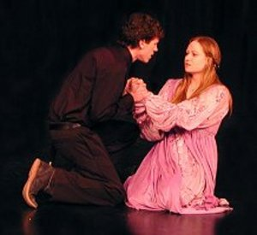
Hamlet: Themes and Issues
Love and Sexuality

Slide 2
Where does Hamlet stand on the issues of love and sexuality?

Slide 3
Hamlet cannot easily contemplate the world around him, or its inhabitants, without weighing and measuring what he sees against his own most demanding moral standards.
Given his experiences of human nature, as represented by the conduct of his mother and uncle mediated to him by the ghost, it is scarcely surprising that he finds humanity in general deeply flawed and other people’s standards and moral choices defective.

Slide 4
What does Hamlet’s morality mean for him?

Slide 5
His strict morality leads him to despise the drunken revels which enliven the court of Claudius.
He finds it incomprehensible that Gertrude should be the happy wife of Claudius, and tells her in considerable detail why her choice of husband has been so misguided, and why her relationship with him is immoral and disgusting (3:4, 49-197).
Hamlet’s selective moral sense can not tolerate the spying activities Polonius carries out in the interests of the state as well as of Claudius.

Slide 6
Hamlet’s Morality
His strict morality leads him to despise the drunken revels which enliven the court of Claudius.
He finds it incomprehensible that Gertrude should be the happy wife of Claudius, and tells her in considerable detail why her choice of husband has been so misguided, and why her relationship with him is immoral and disgusting (3:4, 49-197).
Hamlet’s selective moral sense can not tolerate the spying activities Polonius carries out in the interests of the state as well as of Claudius.

