Slide 1
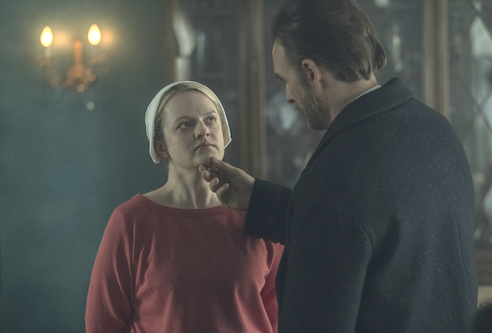
General Vison and Viewpoint
The Handmaid’s Tale – by Margaret Atwood

Slide 2
GVV
This is the author’s view on life in the world of the text.
Is what we see in the text positive or negative?
Is the dominant mood optimistic or pessimistic?

Slide 3
How does the author communicate the GVV?
The opening
The relationships
The main character’s ‘journey’.
By how s/he deals with key themes.
Poverty, love, family, hopes and dreams etc.
The ending (crucial)

Slide 4
Our Sub- headings
1. Beginning of a text
2. World of the text - is it conductive to an optimistic or pessimistic mind-set?
3. How individuals respond to such a world
4. Support (or lack thereof)
5. Relationships (and their effect)
6. Key moment(s)
7. Closing scenes

Slide 5
The structure of the Comparative Essay
There are 70 marks going for the comparative essay
I must write 11 clear paragraphs
LAYOUT:
Introduction
Anchor text (Text A) – Chosen subheading (SH)
Compare Text A with Text B – under your chosen subheading (SH)
Compare Text C with A &B
Anchor text (Text A) – Chosen subheading (SH)
Compare Text A with Text B – under your chosen subheading (SH)
Compare Text C with A &B
Anchor text (Text A) – Chosen subheading (SH)
Compare Text A with Text B – under your chosen subheading (SH)
Compare Text C with A &B
Conclusion

Slide 6
1 – Beginning of ‘Handmaid’s Tale’
The beginning of the text quickly creates a dark outlook on life, establishing the lack of freedom and independence that the narrator and her peers experience in the new society of Gilead; this suggests a bleak semblance of life that does not offer what the reader would expect and desire.
It foreshadows the depressing journeys that many of the characters will take as the text progresses.

Slide 7
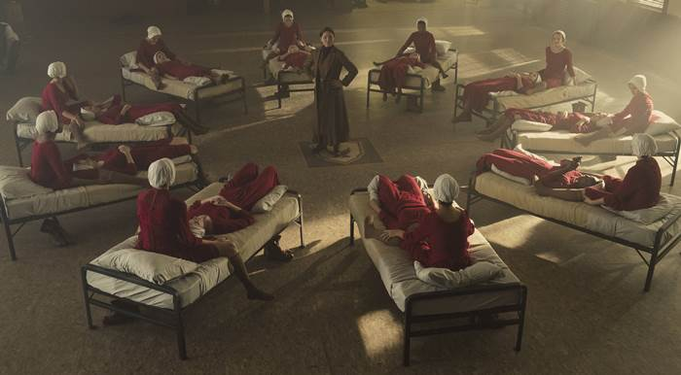
The narrator describes the silent means by which she and her peers communicate, mentioning how “We learned to lip-read, our heads flat on the beds, turned sideways, watching each other’s mouths. In this way we exchanged names from bed to bed: Alma. Janine. Dolores. Moira. June.”
The act of mouthing silently metaphorically represents how the narrator and her peers are not allowed speak or use their real names, and hence the alternative modes of communication are a reminder of the lack of independence available to them.

Slide 8
2. World of the text - is it conducive to a certain mindset, optimistic or pessimistic?
The narrator and other handmaids, as a result of their confined living experience, come to eventually accept the demands of surrounding society and hence forget, at least somewhat, a desire for independence and freedom.
This creates a bleak outlook as it indicates a decline of the human spirit when the surrounding world becomes overbearing, and hence how fundamental values can be lost due to the corruptive influence of others.

Slide 9
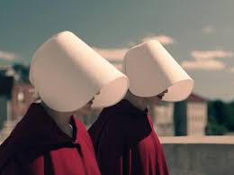
This can be seen when Ofglen is replaced by another handmaid, with the narrator’s means of description (representing how remaining in the confined living experience where she is not allowed fundamental values) leads to a belief that this is the norm.
This is illustrated when she speaks of the replacing, noting how “This woman has been my partner for two weeks. I don’t know what happened to the one before. On a certain day she simply wasn’t there anymore, and this one was there in her place.”

Slide 10
The non-descriptive mode of communicating, where the handmaids are referred to generally rather than specifically, represents how the narrator has become attuned to a way of life where she and her peers are not allowed fundamental values such as identity, which leads to her self-presentation in such a lowly manner.
Even more depressing is that there is no attempt to challenge this, but further acceptance of such conventions: “It isn’t the sort of thing you ask questions about, because the answers are not usually answers you want to know. Anyway there wouldn’t be an answer.”
These women’s personalities don’t matter. They just replace each other when the needs arise.

Slide 11
3. How individuals respond to such a world
The narrator becomes attuned to the ways of life in the world of the text, which bleakly presents how the human spirit can be extinguished when more forceful parties attempt to achieve this.
This is seen when she responds to her living experience through self-description, presenting herself as disconnected from her true sense of self.

Slide 12
The narrator presents herself as split into two parts within the new Handmaid Offred. She says that “I wait. I compose myself. My self is a thing I must now compose, as one composes a speech.” p.76
In the world of the text she must create a new character, akin to an actor on stage, which conveys how she is disconnected from her sense of self.
This also represents her underlying belief that what she is creating, her new ‘composition’, is not reflective of reality but mere fantasy.
Offred would expect and prefer independence to do as she wishes.

Slide 13
4. Support of others (or lack thereof)
As the text progresses the narrator becomes attuned and accepting of the confined living experience in the world of the text.
This creates a bleak outlook as it indicates how one’s viewpoint can be dulled as a result of difficulties.
This suggests that hope and optimism are not constant but can decline due to the damaging influence of others and of society.

Slide 14
We see Offred accepting her world and feeling lonely when she notes signs of loving connections when viewing where others have had sex, which she equates with such a bond: “The stains on the mattress. Like dried flower petals. Not recent. Old love; there’s no other kind of love in this room now.” p.61
She immediately relates this to her own situation and doubts that she will ever experience such a loving connection ever again.
This is represented symbolically by her covering the bed and signs of the loving connection before lying down, creating a divide between love and the narrator that she perceives at present: “When I saw that, the evidence left by two people, of love or something like it, desire at least, at least touch, between two people now perhaps old or dead, I covered the bed again and lay down on it.”

Slide 15
5. Relationships and their effect
The narrator’s relationship with Luke creates a bright outlook not just as it offers a connection that has been lacking for much of the text, but also as it reinforces her belief system.
This counters how the confining world of the text has dulled the narrator’s human spirit and presents how relationships can offer hope and self-belief, indicating first hand the benefits of such bonds.

Slide 16
The narrator illustrates such effects when revealing that she will wait for the message that will reveal Luke’s love; the wait does not depress her, but rather she believes that she will experience a connection with her beloved. (p.116)
This is a subversion of earlier where the speaker’s spirit was extinguished by the demands of those around her, as now it is elevated and expands as a result of the potential of true connection with another.

Slide 17
This, hope that Offred’s relationship with Luke offers, is evident by the definitiveness of tone, which conveys the narrator’s belief in what is to come.
We have seen Offred speak passively before but she is affirmative and confident now: “What has happened to me, what’s happening to me now, won’t make any difference to him, he loves me anyway, he knows it isn’t my fault. The message will say that also. It’s this message, which may never arrive, that keeps me alive. I believe in the message.”
This hope, and this relationship gives us an optimistic outlook on life.

Slide 18
6. Key Moment
The moment where the narrator realizes that society has been able to convince her daughter into forgetting her birth mother creates a dark outlook on life, as it indicates how the overpowering force of others will continue in the text, even if the narrator has experienced an uplift in mood and optimism recently.
This represents how the overriding framework of the text, thatcertain parties who can shape the world damningly for others, cannot be overcome, but only forgotten temporarily. In other words, The Republic of Gilead had succeeded in what it set out to do.

Slide 19
The narrator receives proof that her daughter is alive when given the Polaroid picture by Serena Joy, in return for agreeing to have sex with Nick to increase her chances of pregnancy.
However, the joy she experiences through the proof is quickly dashed as she learns that society has convinced the daughter to forget about her mother: “I have been obliterated for her… You can see it in her eyes: I am not there… I can’t bear it, to have been erased like that. Better she’d bought me nothing.” p.240

Slide 20
The self-description is telling, and bleakly reinforces how the narrator’s mood and viewpoint is ultimately influenced by those around her.
This also indicates that her recent optimism, which recently appeared in defiance of others, is temporary; she presents herself as destroyed.
This is a harrowing metaphor for how she defines herself by her optimism as well as the control that the ‘powers that be’ in her world have resumed over her.

Slide 21
7. Resolution (close of text)
Considering the narrator’s great loss of her child near the close of the text, it is unsurprising that she willingly goes with the men into the van at the close of the text, even if they are not resistance workers.
This represents how she has no other substantial and tangible reason to fight potential damnation, and rather all she has left to base her future viewpoint on is hope.

Slide 22
The carefree manner in which the narrator describes her ending, which has potential danger, represents how she has no connections or parts of life to care about, which could elicit a refusal of sorts to go into the van: “The van waits in the driveway, its double doors stand open. The two of them, one on either side now, take me by the elbows to help me in. Whether this is my end or a new beginning I have no way of knowing: I have given myself over into the hands of strangers, because it can’t be helped.”

Slide 23
The passivity of the narrator’s tone, coupled with her self-presentation as object of the section (the van and men appear as subjects and dominant elements of the piece) convey a lack of desire to challenge a threatening situation.
On one level this appears to create a depressing view of life, as the narrator seemingly has nothing to live for; however, it can be argued that this is also hopeful, as it can be argued that the narrator is not plagued by the demands of others and hence can now solely focus on her hope.
Such can be seen as represented by the symbolic reference to hope in the concluding line of the text: “And so I step up, into the darkness within; or else the light.”

