Slide 1
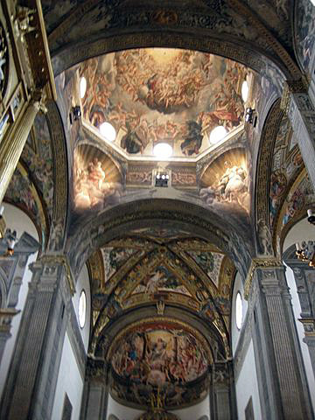
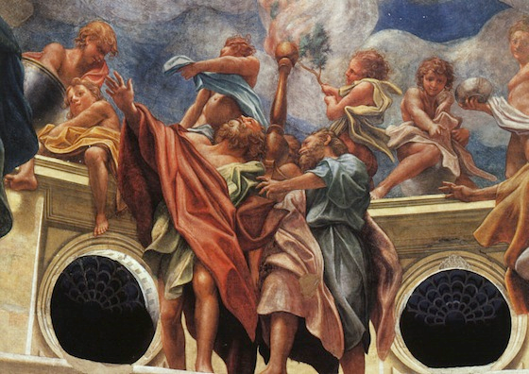
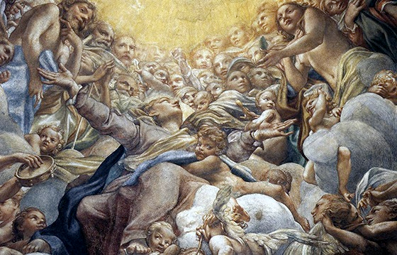
Fireman’s Lift
Eilean Ní Chuilleanáin

Slide 2
Ní Chuilleanáin has said that she was thinking of the death of her mother (Eilís Dillon) when she wrote Fireman’s Lift.
The setting of the poem in Parma, Italy whose dome features Italian Renaissance artist Correggio’s fresco of the Virgin Mary’s assumption into heaven.
Ní Chuilleanáin had visited this cathedral in in 1963 with her mother.

Slide 3
The art and architecture of the dome, the “big tree of the copola”, became a reminder of her mother’s recent death.
Ní Chuilleanáin focusses on the struggles of the angels to lift Mary into the heavens.
This struggle is also connected to the labour and wonder of a mother giving birth – another passage from one form of life to another.
The poem therefore works on several levels.
The poet has said that the care given to her dying mother by nurses, who lifted and supported her during her last illness, is also a part of the inspiration of the poem.
A “fireman’s life” refers to a certain method of supporting the full weight of another person on your shoulders.

Slide 4
In a typical narrative style opening, the poet addresses her mother as she recalls a shared memory.
The wonder and awe that mother and daughter felt in Parma is graphically captured in the description of the domed roof of the cathedral, the cupola, which appears to grow like a tree and then “splits wide open to admit/ Celestial choirs”.
It is almost as if the barrier which is the roof of the cathedral has been swept away to allow the earthly to meet the heavenly.
The phrase “fall-out of brightness” captures the splendour of the occasion depicted in the fresco.

Slide 5
The second stanza continues the narrative. Energetic verbs convey the effort needed as the Virgin’s body is “Hauled up in stages”, “spiralling” towards the heavens.
“Teams of angelic arms” lift, support, heave and crowd around her body, passing her upwards towards the waiting Christ.
The imagery reminds us the energetic efforts made by firemen, working in teams, to haul people from a place of suffering to a place of safety.
Collective effort produces the desired end.

Slide 6
Ní Chuilleanáin then recalls how she and her mother stepped back to see the masterpiece in its totality.
This is something which the painter would have longed to do as his own arm “swept the large strokes”, but this pleasure would be denied or at least deferred for him.
The artist must wait for the completion of his work of art before he can truly see it.

Slide 7
The poet describes seeing the angels and watching saints: “Melted and faded bodies… Loose feet and elbows and staring eyes / floated in the wide stone petticoat / Clear and free as weeds”.
Here, art and architecture meet and are blended together. Within this image of the dome, fringed with a “petticoat” of plasterwork, Ní Chuilleanáin stresses the interrelationship between architecture and the figures in the painting as she describes the angels and saints bending over the ascending Virgin as she passes into another life.

Slide 8
These details present a vivid sense of reality even though the mists obscure the vision somewhat as it moves further towards the dome.
The fifth stanza marks a turning point as the poet reflects on the necessity of letting her mother go, of setting her mother free.
Ní Chuilleanáin realises that like the teams of angels who pass the Virgin from one level to the next level of waiting hands (just as firemen may need to do on occasions), so she must pass her mother on to eternity.

Slide 9
It is a burden for her to do this but one she must lovingly bear. “This is what love sees,” she tells us, referring to the “branch loaded with fruit”.
This image of the tree bearing fruit could be symbolic of her own essential bond with her mother.
She was the fruit of her womb, as Jesus was the fruit of Mary’s womb.
The natural cycle involves birth, life and death and the labour to bring a child into the world involves a letting – go, a separation of sorts. In the same way death demands separation and loss.

Slide 10
The image of the tree laden with fruit could also be applied to the “big tree of the cupola” mentioned in the first stanza which “splits wide open” to allow the brightness to enter.
Mary bore Christ. The tree of the cross bore Christ whose suffering led to resurrection. The poet’s mother bore her, nourished her mind and body and now, after the suffering associated with death, must be passed on, aided in her transition from life to death.

Slide 11
Images of art and architecture blend magnificently in the next stanza.
The limbs of the assisting angels who labour to lift the Virgin heavenwards are blended into the fresco.
We see a “jaw defining itself, a shoulder yoked”, images of effort and determination.
The pillars are likened to supporting arms: the roof made from a back; a bridge from legs while the lifting hands function like a crane offering not only support and height but also gently cradling the body.
The virgin’s face is like a “capital”.

Slide 12
Ní Chuilleanáin said that much of the poem’s inspiration came from the loving support and care given by the nurses who looked after her mother in her last illness.
She now sees these nurses as being similar to the supporting angels in the fresco, “Their heads bowed over to reflect on her … as she passed through their hands.”
Her mother’s endurance is reflected in the “muscles” which clung and shifted as she moved ever closer to the “edge of the cloud.
At this point, the Virgin Mary, a mother, is blended with the image of her own departing mother.
There is the same mystery of what lies beyond the cloud which acts as the boundary between what is known and what cannot be known or fully understood.

