Slide 1
Evil in Macbeth

Slide 2
Evil - Intro

Slide 3
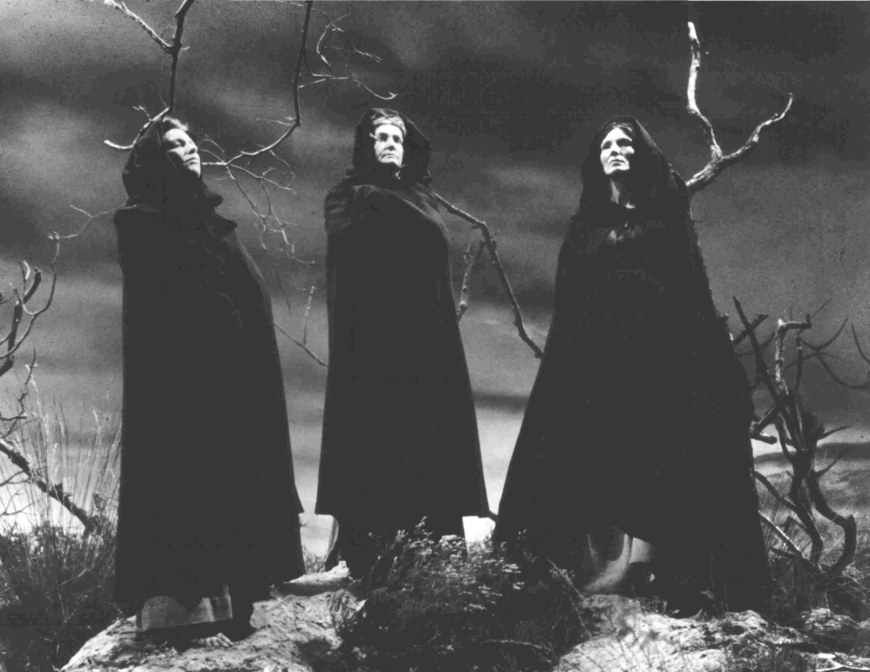
Evil - Witches

Slide 4
Evil - Witches
Supernatural embodiments of evil
Cruel misleading actions that cause suffering
First characters we meet
Have power over events and supernatural knowledge
Power used for evil purposes – wreak havoc
Examples:

Slide 5
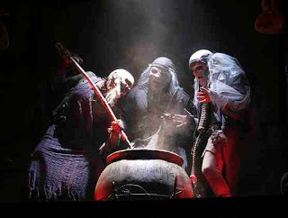
Evil – Witches’ Treatment of M

Slide 6
Evil – Witches’ Treatment of M
Wicked treatment of Macbeth
Goal – not to lead M to power but to...
Love the false sense of security they give him
He curses them for showing him the truth and they do a crazed dance and disappear
They have dedicated themselves to evil
Apparitions scene

Slide 7
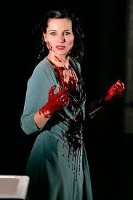
Evil - LM

Slide 8
Evil - LM
The other major force of evil
Delights in the pursuit of evil for evil’s sake
Taunts and blackmails her husband
First time – wishes to pour evil into M’s ear
True nature – she invokes the evil spirits
Furious at her husband’s kindness
Savage inhumanity in her shocking declaration

Slide 9
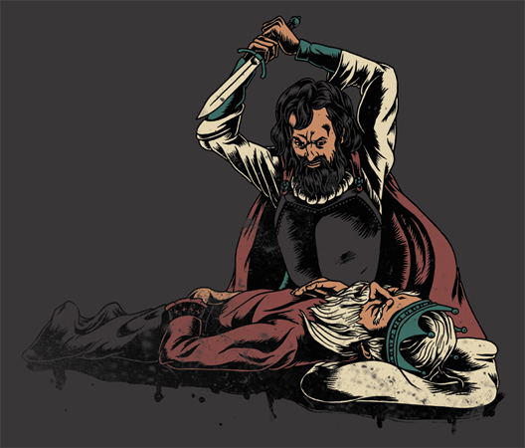
Evil - M

Slide 10
Evil - M
Commits murders, wicked deeds, remorseless
(Despite the fact that he is encouraged)
Most evil act for contemporary audience –
Audience – horror and disbelief
Echoed in Macduff’s language
A first step for Macbeth – cannot return
Blood imagery symbolises guilt and wickedness

Slide 11
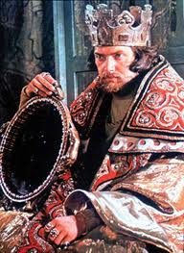
Evil – M’s Descent

Slide 12
Evil – M’s Descent
Believes the witches’ misleading prophecies
Murders his life-long friend and comrade
Lose respect for M – he puts greed for power above morality
M – acting on impulse
Slaughters Macduff’s entire family
Meaningless acts of violence

Slide 13
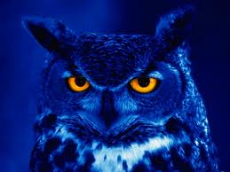
Evil – Pathetic Fallacy

Slide 14
Evil – Pathetic Fallacy
Evil – further presented through pt
Violent evil deeds reflected in parallel upheavals
Examples
Unnatural acts mirror the evil in reality

Slide 15
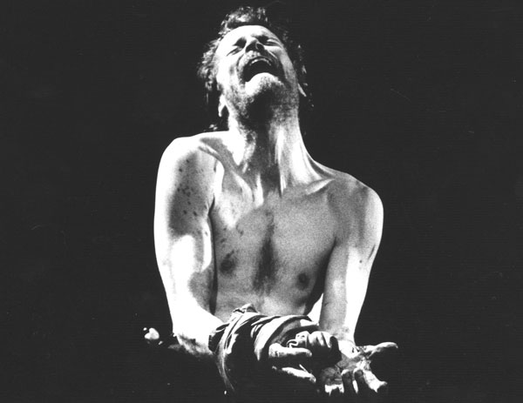
Evil – Innate*

Slide 16
Evil – Innate
Not external forces
But from within
Witches only make suggestions
Macbeth consciously chooses his actions
Continues alone on his course of evil
Evil is inherent in the character of Macbeth

Slide 17
Evil - Conc

Slide 18
Evil – External Forces Represent E*

