Slide 2
Students agree or disagree or partially agree with the statement that
Dickinson’s unique poetic style
- condensed poetci forms
- compressed language
- broken rhythm
-unconventional punctuation
- haunting aural effects
- unsettling humour
- intriguing perspective
- insightful reflection
-vivid dramatization
- surreal imagery
- quirky precise details
- etc.

Slide 3
… is particularly suited to the exploration of
her extraordinary experiences
- hope/despair
- loss
- death/afterlife
- consciousness/ disorientation
- profound reactions to the natural world
- etc.

Slide 4
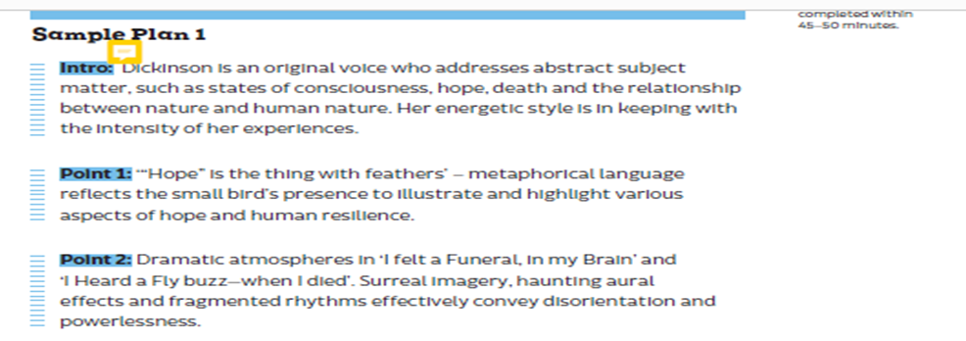

Slide 6
H1 Sample Paragraph

Slide 7
Write your own paragraph on any other poem of your choice
Afterwards, read the following sample and decide is your work more like the H1 answer or the following H3/4 answer

Slide 8
H3/ 4 Sample

