Slide 1
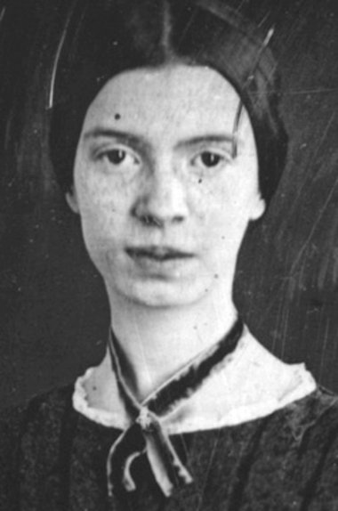
Emily Dickinson

Slide 2
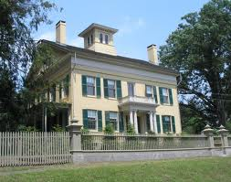
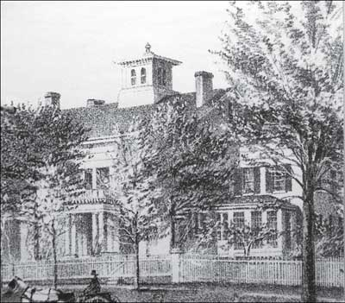
Born in Massachusetts on December 10th, 1830
Her father was a lawyer and served as the treasurer of Amherst College
Went to a Calvinist school
The poet was born in, and died in, a house called the Homestead , built by her grandfather

Slide 3
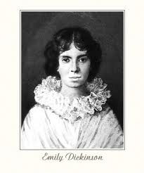
During her mid-twenties, she began to grow reclusive. She attended almost exclusively to household chores and to writing poetry.
She dressed only in white and developed a reputation as a reclusive eccentric.

Slide 4
From the late 1850’s she assembled many of her poems in packets which she bound herself with needle and thread.

Slide 5
Although she was a prolific private poet, less than a dozen of her nearly eighteen hundred poems were published during her lifetime
The few poems published during her lifetime were anonymous

Slide 6
On May 15, 1886, after several months of illness, Emily Dickinson died at the age of 55

Slide 7
What Her Poetry Entails
Dickinson’s poetry explores her morbid fascination with death and the question of whether or not there is an afterlife; mental anguish and depression; the beauty and wonder of the natural world; and the essence of human emotions, both positive and negative. There is also a wonderful, playful, humorous quality in Dickinson’s work.

Slide 8
Dickinson never declared herself a Christian, she spent a lifetime exploring the nature of the soul and the spiritual self.
Her poems are influenced by the rhythm of Protestant hymns and the bible is a major source of her direction and imagery

Slide 9
Dickinson died at the age of 55 following a period of ill health.
The appeal of her poetry has much to do with the range of emotions it expresses.
While her poems reveal that she experienced moments of deep joy, they also indicate contrasting moments of doubt and uncertainty.

Slide 10
Ultimately, the inherent power of her poetry is incontrovertible and at the root of its enduring popularity.

