Slide 1
Elizabeth Bishop

Slide 2
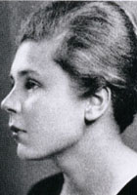
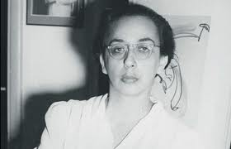
Childhood
born on 8 February 1911 in Massachusetts
Father died when she was a baby
Mother suffered from a mental illness
Brought up by grandparents and aunts

Slide 3
Main Themes
CHILDHOOD
Childhood is presented as a precious entity which is threatened by external factors.
Her Father died when she was only 8 months old and her Mother went insane with grief, being institutionalised when her daughter was 5 years old.

Slide 4
Bishop was raised by various family members and, as a result, never felt that there was a place she could call home.
Her happiest childhood days were spent under the care of her Maternal grandmother at Great village, Nova Scotia and many of the places described by Bishop in her poems reflect various aspects of this idyllic place.

Slide 5
Bishop's poetry displays her need throughout her life to find stability and order. Or rather, not so much to find stability and order as to create them.

Slide 6
She could not believe in the existence of God or of any transcendental source or guarantee of order, but she regretted not being able to do so. She wished the world were a more ordered place, but she knew that she had to create the order herself, and it is her poetry that allowed her to do so.

Slide 8
You could argue that Bishop was traumatised by the events of her youth and that she never really knew her parents.
She received an inheritance that allowed her to not have to work for most of her life.
Wrote 1700 poems in her life

Slide 9
Death

Slide 10
Grief

Slide 11
Loss of Childhood Innocence

Slide 12
The chaotic nature of existence

Slide 13
Travel

Slide 14
Note how Bishop writes about experiences (I caught a tremendous fish) rather than emotion from first principles. This is more characteristic of American poetry

Slide 15
Bishop's poetic voice is very distinct. She combines a fine-tuned sense of poetic formality with an elegant lightness of phrase, and she is never afraid of striking a conversational tone.
Also, her work is replete with vivid imagery and striking metaphors, and the keenness of her perception of the details of the world about her is remarkable.

