Slide 1
Eavan Boland – The Famine Road

Slide 2
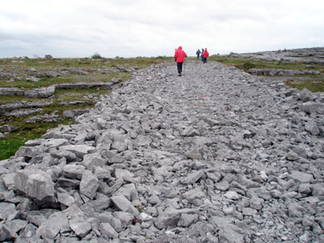
background
Charles Edward Trevelyan (1807-1896) was a British civil servant and colonial administrator charged with overseeing food supplies to the Irish during the Famine. He has been heavily criticised for the way he handled the situation as he denied emergency relief and viewed the famine as the fault of the Irish people. ‘The greatest evil we have to face is not the physical evil of the famine,’ he wrote, ‘but the moral evil of the selfish, perverse and turbulent character of the Irish people.’ In an 1848 article in the Edinburgh Review - at the height of the famine - he applauded the fact that starvation encouraged migration and supported the view that God was punishing the Irish Catholics for their superstitious ways and adherence to 'popery'. He was knighted by Queen Victoria that same year for his work on the famine

Slide 3
There are two dramas being played out in the poem: the famine, and a woman’s infertility problem. These two dramas are interlinked, happening as it were on two different stages, but linked by theme and mood.

Slide 4
Summary
Eavan Boland keeps herself out of this poem: there is no ‘I’, but the strength of her feelings is clear nonetheless. The poem is divided into two sections; in one we hear the voice of Trevelyan and Jones and in the other we hear a doctor speaking to a patient. Boland links the suffering of the Irish during the famine to the suffering of a childless woman. The plight of the famine victims and of the woman are treated with detached disdain and a distinct lack of sympathy by those in authority.

Slide 5
The poem opens with a letter from Trevelyan to Jones in which he dismisses the suffering of the Irish and says they deserve ‘no coins’ or any sort of relief. Instead, he suggests that these starving and sick people be put to work in order to cure their inherent laziness and improve their characters. His tone is peremptory: in his arrogance Trevelyan presumes to know what is best for the Irish people.

Slide 6
The language used in the letter is both familiar and foreign as Boland uses slightly archaic phrasing and similes: ‘Idle as trout’, ‘give them no coins at all’. Trevelyan’s ignorance is also clear in these opening lines. After all, the Irish were peasant labourers and were well used to lives of toil and hardly likely to have had the luxury of being idle. If they weren’t working it was not out of choice but because the potato crop had failed and they had nothing to farm.

Slide 7
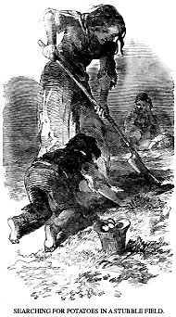
The Relief Committee deliberate on the best way to handle the situation and tentatively ask if it might be an idea to set the Irish to work building roads that go nowhere. This suggestion is a mixture of the cruel and the ridiculous: the suffering and starving Irish will be worked so hard at this pointless task that they will be unable to threaten the safety of those responsible for their situation. There is no thought of the safety of the poor and the dying. The roads will lead nowhere, just as most of these people’s lives will lead nowhere.

Slide 8
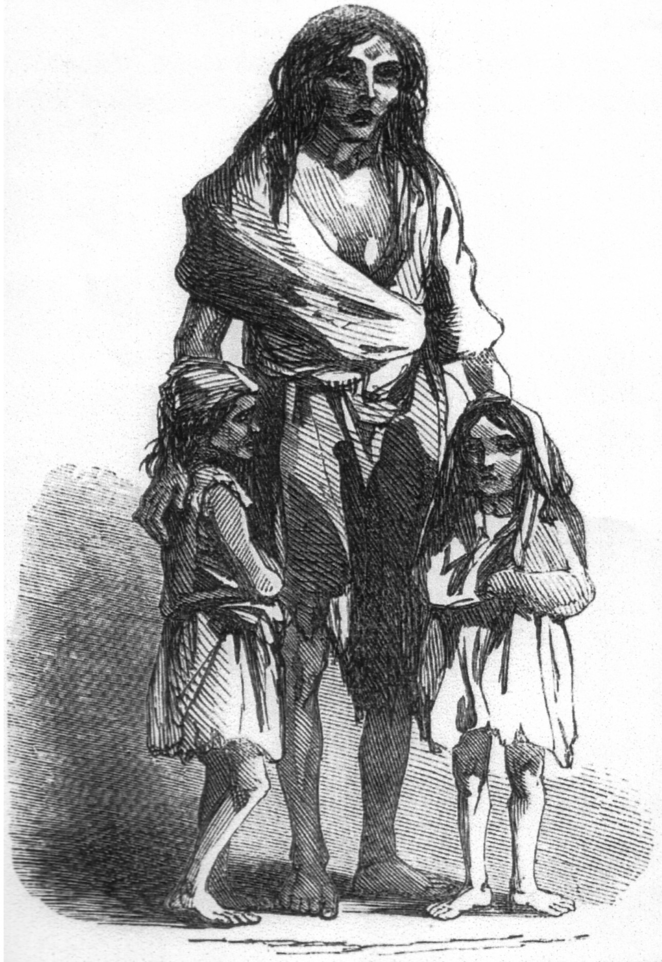
Doctor = same as Trevelyan
The poem now moves on to the voice of a doctor speaking to a female patient. Neither is named and the doctor’s speech is introduced mid-sentence (The line does not begin with a capital letter). He dispassionately discusses the woman’s health issue in terms of statistics and averages. His tone reminds us of the detachment and coldness with which Trevelyan summed up an entire people as ‘these Irish’; here the doctor sees the woman in front of him as merely another of these women who present with a similar condition.

Slide 9
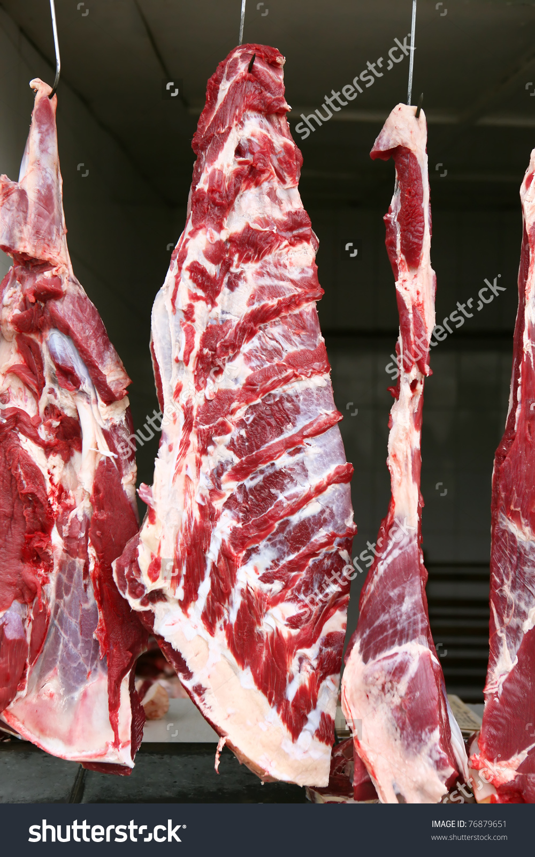
The workers’ plight means that they are driven to looking at one another much as cannibals might eye up a prime piece of meat. The juxtaposition of this image with the everyday image a housewife selecting a joint in a ‘corner butcher’ is horrifying as it makes the idea of feasting on the dead flesh of fellow workers as normal as choosing a piece of meat for dinner.

Slide 10
We move back to the doctor talking to the patient. He tells her in rather offhand way that ‘anything might have caused it’, be it spores – which makes us think of the spores causing the potato blight – or a mere accident in childhood. The doctor is blasé. He does not seem to realise the devastating effect of his words, just as Trevelyan seemed to show no understanding of the effect his words would have on the lives of tens of thousands of innocents.

Slide 11
The doctor gives some advice to the woman that he feels is practical and worthwhile. If she busies herself in the garden and in the house – much as the Irish in Famine times were kept busy building pointless roads – then she will be better off. This makes us think of the starving Irish who were ordered to do the same thing in order to earn food – were they better of as a result of it or was it an imperious command dealt from on high?

Slide 12
From the woman’s point of view, keeping her house and garden tidy is as pointless as building a famine road. Her efforts are going nowhere. She wants a child and a future and the doctor’s words are meaningless platitudes at best and insulting condescension at worst.

Slide 13
In the final stanza, the fact that Jones is travelling in a carriage while the Irish laboured and died on the road highlights the discrepancy between those in authority and those they are supposed to be .
The Irish are not people now but merely ‘bones’. They have been completely dehumanised by their suffering and their treatment at the hands of the British.

Slide 14
The poem ends with the woman’s thoughts. She bleakly views her body like a famine road going nowhere. This is a strange metaphor in that it implies the only purpose of a woman is to bear children. In both narratives – the story of the famine and the story of the woman – there is a strong male voice. Trevelyan, Jones and the doctor are all seen as dominating and insensitive figures.

Slide 15
Boland’s linking of the public and the private here is masterly. The intersection historical and the emotional is the oppression and the silencing of the victims. The comparison between the way the Irish were treated by the English and the way women have been treated in Irish society is explained as follows by Boland: ‘Womanhood and Irishness are metaphors for one another. There are resonances of humiliation, oppression and silence in both of them and I think you can understand one better by experiencing the other.’

