Slide 1
Eavan Boland – The black lace fan my mother gave me

Slide 2
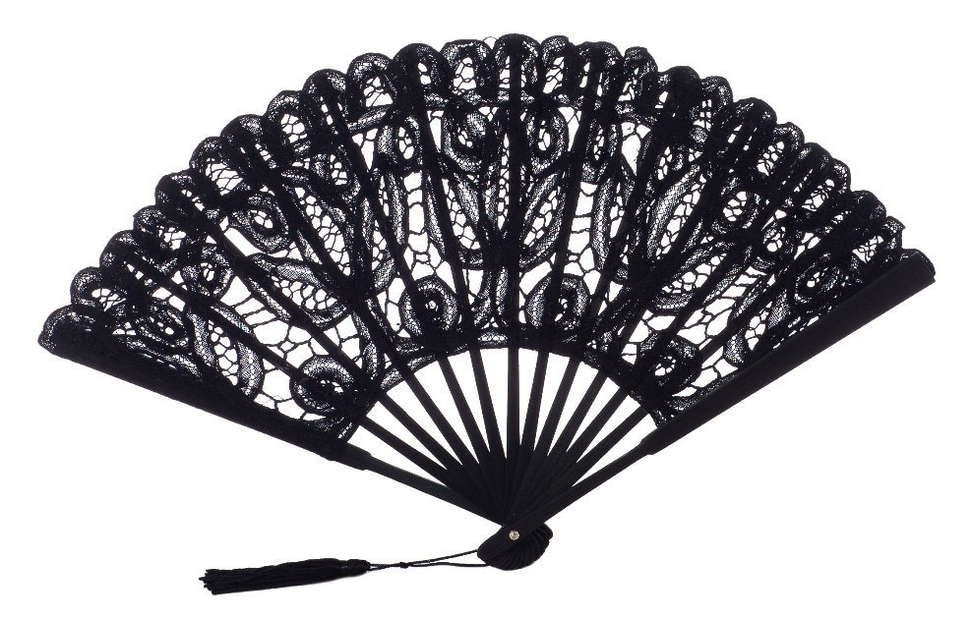
title
The title of the poem focuses on an object.
The “Black Lace Fan” is of personal significance to the speaker because her mother gave it to her. It is unusual for Boland to refer to herself in the title of the poem.
As we read the poem, this reference to herself as daughter begins to make sense.

Slide 3
The poem opens with factual events.
This narrative is part of her family history and one gets the impression that the details have been lovingly recounted and repeated and are now fondly recalled by the poet.
Every detail is important. The language is intensified by alliteration: ‘gift, gave, Galeries’, ‘first, five francs’, ‘pre-war Paris’, ‘stifling, starless, stormy’

Slide 4
Language in the first stanza
The poem recounts an emotionally charged moment and is very atmospheric. The place itself, a café in pre-war Paris, and the night ‘stifling’, ‘starless’ and ‘stormy’ creates the atmosphere. The very short sentence, ‘It was stifling’ is almost a gasp, as if the heat prevents elaboration. All the elements of the stanza amount to a very accomplished and atmospheric sketch of a moment in the past.

Slide 5
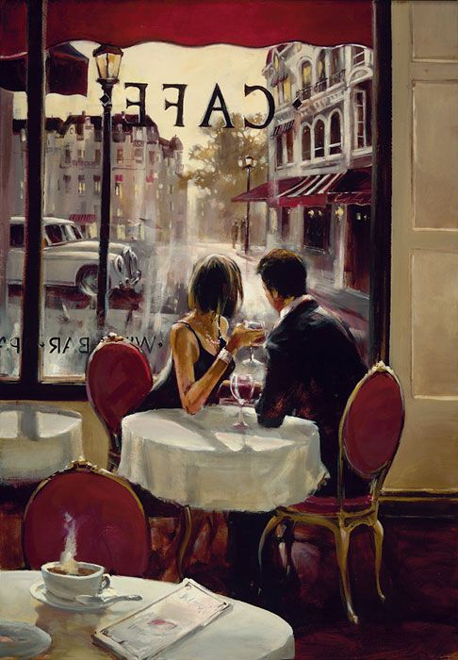
Stanza 2
The second stanza is made up of very short sentences.
Each pause registers the intensity of this time in her parents’ lives.
They are caught up in something momentous. The sibilance of ‘stayed…city… summer’ heightens the language.
The effect of the short sentences is cinematic.

Slide 6
Stanza 3
In the third stanza, she focuses on her waiting mother. It captures the tension of waiting and the excitement and anxiety of new love. Her mother is uneasy and impatient. The effect is intensified by the repetition of ‘she’
She looked down the Boulevard de Capucines
She ordered more coffee. She stood up.

Slide 7
As the streets empty of people, she seems not to be able to decide whether to stay or leave. Again we are reminded of the intense heat: ‘The heat was killing’. The repetition of this detail and the threat of storm, ‘She thought the distance smelled of rain and lightening’ lends atmosphere to the moment and may suggest that her mother is struggling with overpowering emotions.

Slide 8
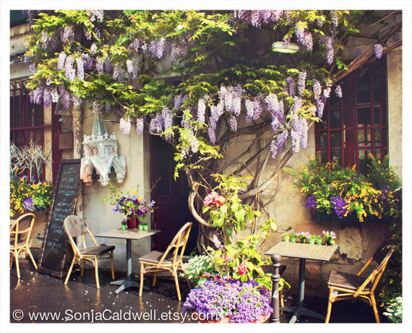
It is not an idealized or romanticized version of her parents’ early relationship. There are troubling aspects to the description – stormy clouds- suggesting an omen of trouble to come.

Slide 9
Stanza 4
Where the Parisian scene was captured in deft and sketchy details, the description of the fan is vivid and beautifully realized. The image of ‘wild roses’ is romantic. They are ‘appliqued by hand’ and therefore artistic.
The creativity and craft of the creator is captured in dramatic verbs and adverbs: ‘darkly picked, stitched boldly, quickly’. The repetition of consonant clusters, ‘k’ and ‘l’ sounds, gives the verse a musical quality (‘appliqued… silk… darkly picked… boldly, quickly) The music is a perfect accompaniment to the beauty of the object and reflects her imaginative engagement with it.

Slide 10
Stanza 5
The tortoiseshell is described as ‘a worn-out underwater bullion’, a kind of treasure taken from the sea.
It endures as her parents’ relationship has endured. However, although it is beautiful and lasting, the fan is also associated with violence.
There is violence in its origins and it ‘keeps even now, an inference of its violation’. It is a romantic gift, a beautiful thing but also a symbol of suffering.

Slide 11
Stanza 6
Stanza six opens with a metaphor, ‘The past is an empty café terrace / An airless dusk before thunder’.
It suggests that the past is unknowable. ‘A man running and no way now to know what happened then – none at all’ The words ‘now’ and ‘then’ are key.
We can never know now what happened then, but we can‘improvise’ as Boland does now.
It is Boland’s improvisation that has brought this poem to life. It is a creative act, as the poem is, but Boland insists on the mystery of the past and the inaccessible emotions of others.

Slide 12
Stanza 7
The final image links the past and the present. In the blackbird , on another ‘sultry’ ‘summer’ day, she sees an echo of the fan.
With a flourish, ‘Suddenly, she put out her wing - / the whole, full, flirtatious span of it’. It is thrilling to the poet to witness this moment because it resonates with her past.
The moment of her parents’ meeting, when her mother may have flirtatiously opened the fan and delighted in it is denied to her.
She can not experience it first-hand. But now, through poetry, she gets to ‘experience an experience’ ‘the whole, full, flirtatious span of it’.

Slide 13
The fan
The fan itself is a gift and therefore symbolic of their love. As an object, it is both practical in a heat wave, but also an object traditionally used in flirtation and courtship.
It represents this moment in the past, and, since it has been passed on to the next generation, just as the story has, it represents how the past lives on in the present, in memory

