Slide 1
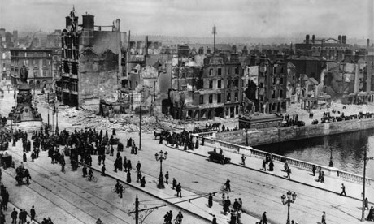
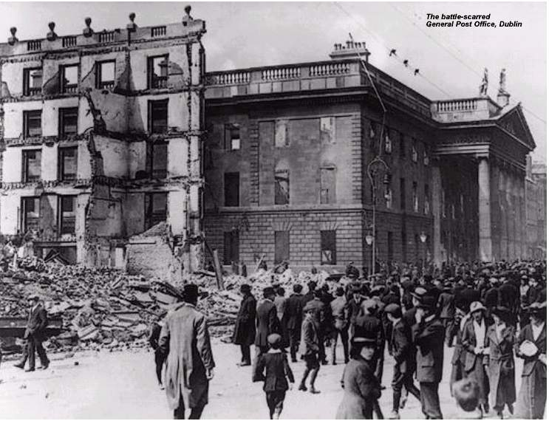
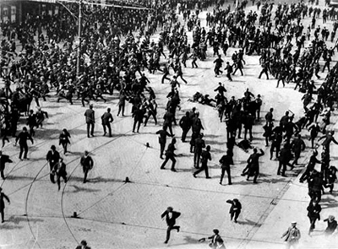
Easter 1916
WB Yeats

Slide 2
Background
Composed between May and September 1916
The poem was not actually published until 1920
The poem commemorates the Easter Rising of 24th April 1916
Yeats himself said that a main theme of the poem is “terrible beauty” and said of the events of the poem:
“I had no idea that any public event could so move me – and I am very despondent about the future. At the moment I feel all the work of years has been overturned, all the bringing together of classes, all the freeing of Irish literature and criticism from politics.”

Slide 3
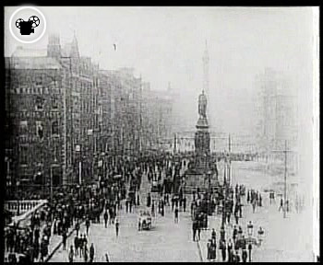
The Easter Rising
The Easter Rising took place on April 24th 1916 in Dublin.

Slide 4
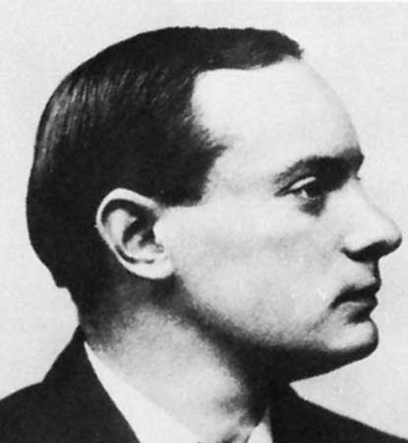
About 1,600 members of the Irish Republican Brotherhood under the leadership of Patrick Pearse rose against British rule of Ireland.

Slide 5
They issued a Proclamation setting up ‘the Provisional Government of the Irish Republic’ and took over several major buildings in Dublin, especially the GPO.

Slide 6
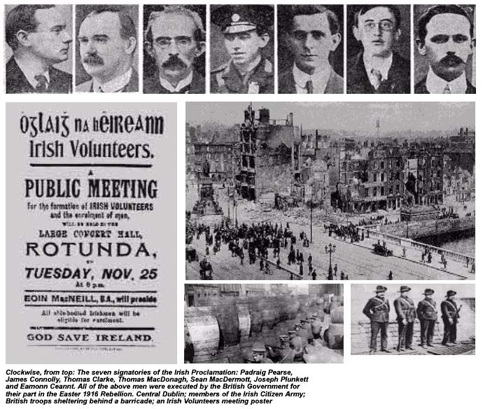
After fierce fighting, they were defeated by the British Army.
Fifteen of those who took part in the Rising were executed in May 1916

Slide 7
This is another political poem
In it he revises the views expressed in September 1913
In this poem, Yeats implicitly acknowledges that he misjudged the middle classes.
The Easter Rising proved that the spirit of self-sacrificing patriotism was in fact very much alive in Ireland

Slide 8
Stanza 1
Yeats passes some of the men who would later fight in the 1916 rising
Talks about the unremarkable men – leading routine lives
He believed that he lived in a world of fools
The first stanza ends with a powerful and paradoxical image which encapsulates the complexity of the Easter Rising and the poet’s conflicting emotions

Slide 9
The paradoxical notion of a “terrible beauty” suggests Yeats was very much in between two minds about the Rising.

Slide 10
Stanza 2
In this stanza Yeats describes some of the leaders of the Rising
Mentions
Countess Markievicz
Patrick Pearse
Thomas MacDonagh
John MacBride

Slide 11
Stanza 3
Dominated by the image of a stone in a stream
Yeats uses the image of a stone to suggest the impact of the Rising on Irish life and History
Stone hearts suggests the men of 1916 were blindly devoted to a dream

Slide 12
The image of the stone in the stream suggests that the Rising is a permanent presence or unchangeable reality in the stream of life

Slide 13
The closing line in stanza three underlines the idea that, through their deaths and subsequent transformation into heroes, the men of 1916 have transcended time.

Slide 14
The images of hearts of stone continue into the final stanza
The comparison of the men of 1916 to impulsive children is perhaps the only unsatisfactory aspect of this poem because it seems to suggest that the rebels were somehow not responsible for their own actions

Slide 15
The poem concludes with the memorable, paradoxical image of the Rising as a “terrible beauty”.
Yeats is acutely aware of the problematic aspects of the Rising.
This poem is particularly memorable for Yeats’ use of powerful imagery and symbolism and simple, direct expression.

