Slide 1
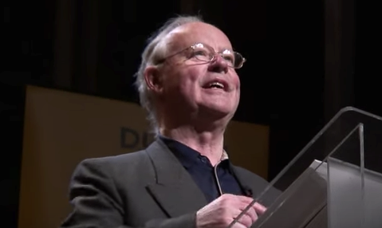
Brendan Kennelly

Slide 2
Background:
Kennelly was born in Ballylongford in Co.Kerry in 1936.
His father ran a pub and his mother was a nurse. He had two teachers, however, who inspired him to during his youth (especially Johnny Walsh, four-time All Ireland Winner for Kerry – who taught him about poetry).
At 17 he went to Trinity College Dublin to study English and French.
Trinity College became somewhat of Kennelly’s home as he went from being a student to a teacher and living there until his retirement in 2005.

Slide 3
Kennelly is still writing and giving public performances to this day.
He is known nationally as his poetry bridges a gap between rural and urban Ireland.
In 1969 Kennelly married Peggy O’Brien and they had one daughter, Doodle.
Their marriage ended in 1981.
However, he considers his battle with alcoholism to be the toughest challenge he has ever faced.
He stopped drinking in the mid 80s but in interviews he has described breaking out in sweats, taking cold showers and going for long walks to avoid alcohol!

