Slide 1
Bogland
Seamus Heaney

Slide 2
About his poem - Bogland - Seamus Heaney told the following: "The title of the poem refers to the bogs I knew while I was growing up and the stories I had heard about the things that could be preserved in the bog such as supplies of butter that were kept there, and about the things that were even more astonishing to a child, such as the skeleton of an Irish elk which our neighbours had dug out". Heaney

Slide 3
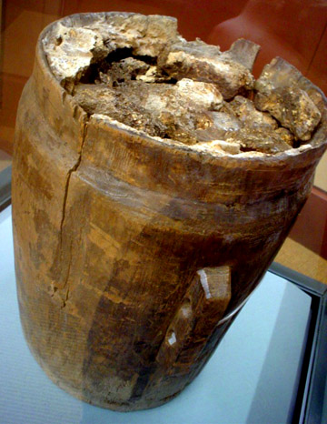
Bog Butter
For many years farmers and turf cutters have been finding huge lumps of what looks like butter in the peat bogs of Scotland and Ireland.
The 'butter' is a waxy substance, usually a creamy white or very pale yellow colour. Lumps dating back as far as the Bronze Age, 3000 years ago, have been found in barrels, baskets or animal skins. They're buried in holes deep in the bogs.

Slide 4
The Great Irish Elk

Slide 5
Dedicated to the painter TP Flanagan, who spent a holiday with Heaney in Donegal.

Slide 6
For Heaney, bogs are storehouses of the past and keys to the culture of the people who worked in them and lived alongside them.

Slide 7
The poem works on both a literal and metaphorical level, which is superbly blended in the structure of the poem and maintained throughout.

Slide 8
Stanza 1
The prairies suggest an unlimited, vast space of land, capable of wide, unrestricted exploration and opportunity.
In Ireland our sight is drawn downwards.
The word ‘concedes’ suggests a more restricted or limited view of life.

Slide 9
Stanza 2
The Cyclops eye brings an imaginative image of singular, focused, yet narrow vision which distinguishes the Irish psyche.
Our “country/ is bog” that keeps changing or “crusting” under the eye of the sun.

Slide 10
Stanza 3
This stanza implies that the depths of the bog may be less dramatic than the prairies of America, but they are repositories and storehouses of history.
Poet remembers elk incident from his childhood.
The word ‘astounding’ captures the poet’s sense of wonder and awe at the amazing discovery.

Slide 11
Stanza 4
The bogland also acts as a preserver.
Preservation of the butter, which is returned as a gift to a later age, inclines the poet to think of the bog as being “kind”.

Slide 12
Stanza 5
“Inwards and downwards” suggests the depth and complexity of racial consciousness, multi-layered and incapable of total revelation.
(American prairies – outward looking, no barriers)
Irish mentality – more inward looking

Slide 13
Stanza 6
“Inwards and downwards” suggests the depth and complexity of racial consciousness, multi-layered and incapable of total revelation.
(American prairies – outward looking, no barriers)
Irish mentality – more inward looking and restricted.

Slide 14
Stanza 7
The final stanza seems inconclusive, “bottomless”.
The stripping away of the layers only reveals more.
The poet here is using the bog, not only as symbolic of the Irish psyche, but also as symbolic of his own search as a poet to find identity and truth.

Slide 15
Like a pioneer he digs into the layers of his subconscious, uncovering the memories and emotions that define him as a person and inspire him as a poet.

