Slide 1
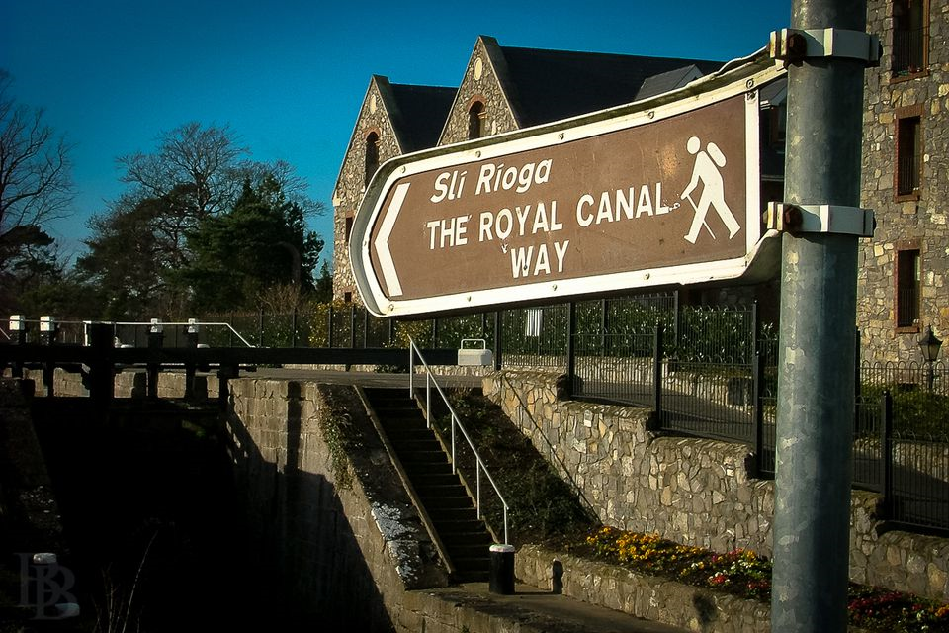
Begin
Brendan Kennelly

Slide 2
The opening:
The poem’s title is also its theme: it is a poem about starting again.
Kennelly considers this idea in two distinct ways. At times, he treats new starts as something literal and everyday.
But, intriguingly, he also describes new beginnings in more abstract and spiritual terms in his single stanza poem of 24 lines.

Slide 3
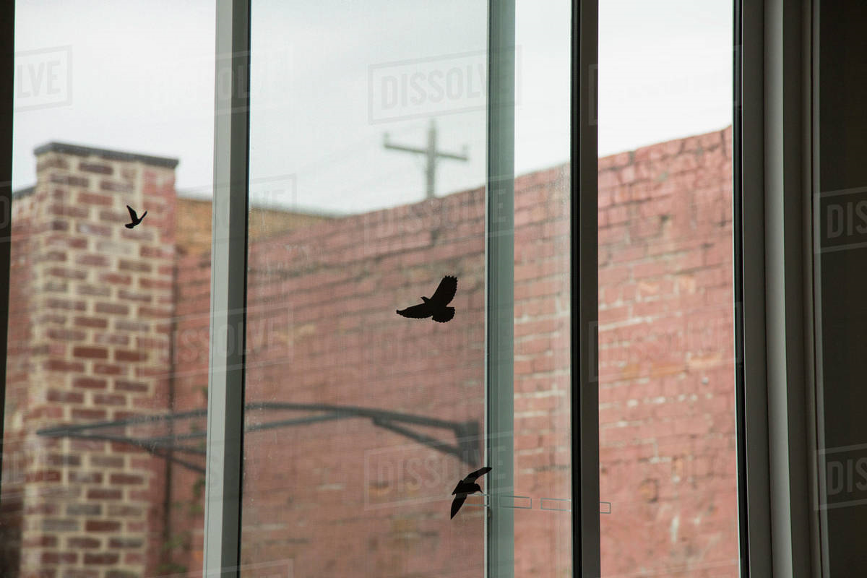
He opens with the defining word of the poem: “Begin again to the summoning birds/ to the sight of light at the window.
The melodic internal rhyme creates an atmosphere bursting with optimism.
It is important to note “where” this poem is about not “what” it is about.
This is a Dublin poem. “begin to the roar of morning traffic/ All along Pembroke Road,”
As readers, we are swept along by the mixture of personification and alliteration – the multitude of “r” sounds carries us along the Southside city road.

Slide 4
In the fifth line the poem moves into a more abstract phase.
Kennelly uses more alliteration, repetition and enjambment to create an alluring rhythm.
“Every beginning is a promise/ born in light and dying in dark/ determination and exaltation of springtime”.
The new starts become something to be embraced rather than feared as Kennelly considers his theme more thoughtfully.
Spring represents new life in nature, and the poet thinks this is something wonderful and glorious.

Slide 5
The ninth line returns to the literal world and the poet’s fascination with Dublin urban life.
The imagery is somewhat quaint and perhaps romanticised:” Begin to the pageant of queueing girls / the arrogant loneliness of swans in the canal.”
The metaphor of women going about their daily business seems a little dated; however, there is poignancy to the swans, reinforced by how indifferent they appear about their situation.

Slide 6
He describes the canal lock bridges as “linking the past and future”, and there is something telling about this metaphor.
Kennelly himself is linking history to the future as he joins the ranks of male Irish writers, such as Patrick Kavanagh and Brendan Behan (1942-64), who have immortalised Dublin canal life.
They, as much as the commuters, are the “old friends passing”.

Slide 7
The Kerry poet’s musings are more philosophical as we move beyond the half-way point of this free-verse poem.
“Begin to the loneliness that cannot end / since it perhaps is what makes us begin.” – Isolation drives people to seek new connections.
His heavy use of ‘s’ alliterative sounds (ie sibilance) here redirects us to the theme of the poem.
This can be read as a bold and reassuring statement.
Kennelly is saying that even those in solitude are at the first stage of a new beginning, and this is something to be embraced.

Slide 8
The tone of joyous discovery is enhanced through repetition, as the poet calls on readers to enjoy the images of nature and human life along the canal: “begin to wonder at unknown faces / at crying birds… / at seagulls…/ at couples…”.

Slide 9
Kennelly finishes the poem by taking the readers back to the start.
He contrasts the “world that dreams of ending / That always seems to be about to give in”, with a more optimistic and hopeful vision.
There is a spirituality to the final lines, a sense of something greater than the things we see, a foregrounding of feelings above physical things.
“Something that will not acknowledge conclusion”, he writes, “insists that we forever begin”.
He leaves us with the title and it feels like a mantra; readers must consider what motivates us to start anew, even when we know all things must pass.

