Slide 1
Base Details
Siegfried Sassoon

Slide 2
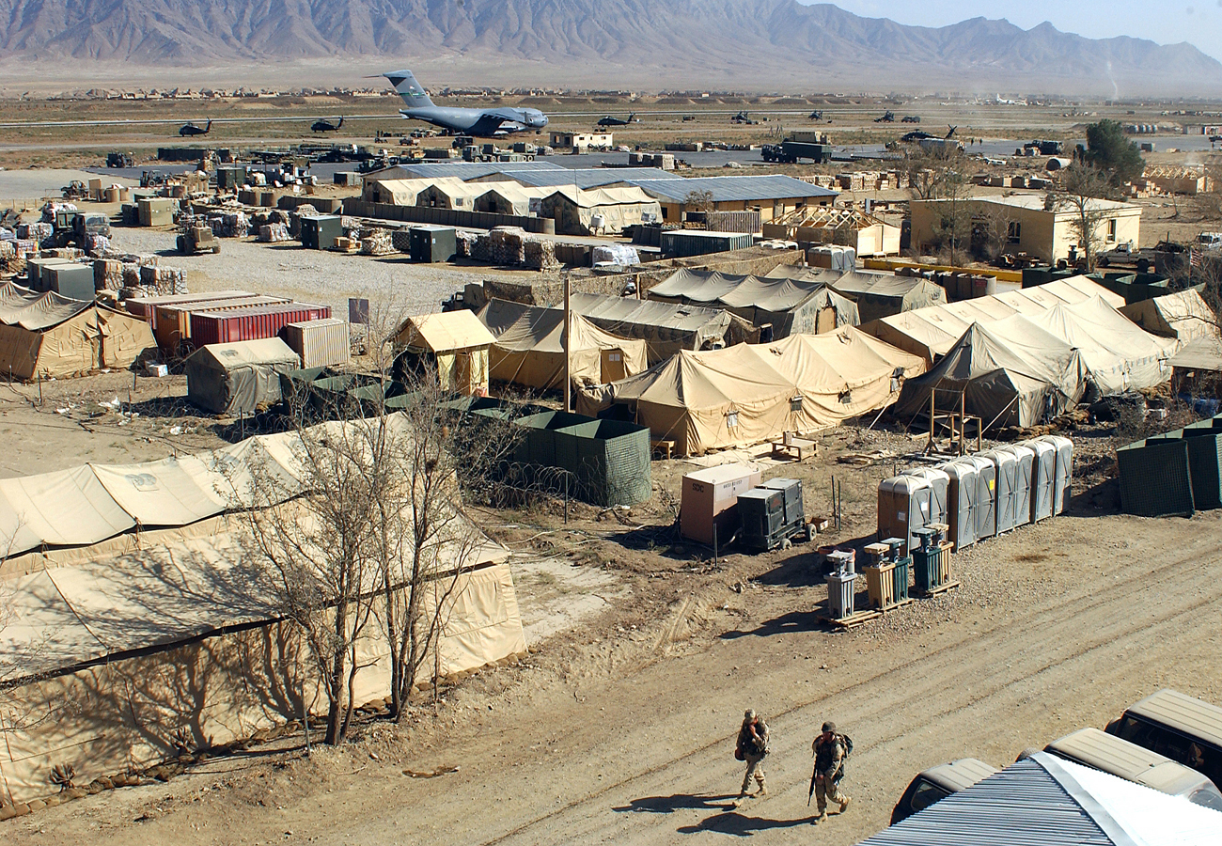
Title
In the title, the word base represents a military base because the poem is about war.
Base also means bottom. In this case, base represents the poorly treated soldiers.
In the poem, the well of life of a major is compared to the horrific life of a World War I soldier.
This Photo by Unknown Author is licensed under CC BY-SA

Slide 3
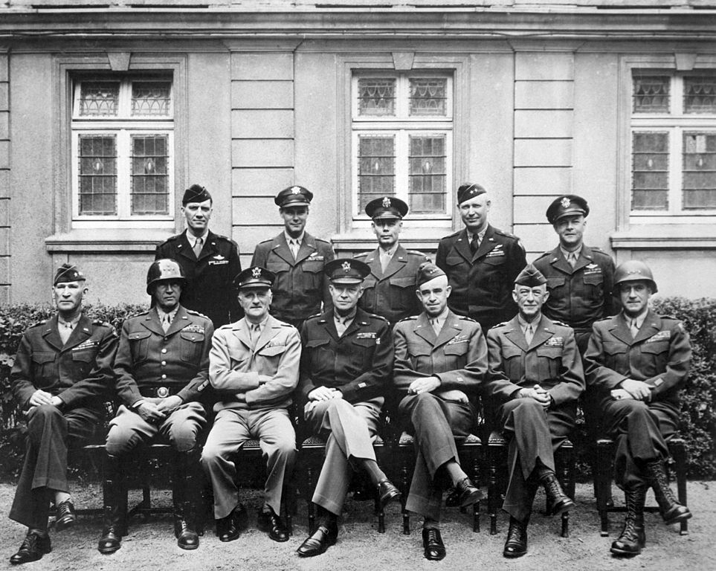
Base Details is a short, scathing poem about the inadequacy of British leadership during the First World War, and an indictment of the same system that allowed underqualified men into positions where they commanded great numbers of troops.
It is well worth remembering that higher ranks were only available to men of some means and money who could afford to buy the uniform; therefore, the British army was primarily composed of the poor at the bottom, and the rich at the top, where the rich were mostly useless at leading troops.
This Photo by Unknown Author is licensed under CC BY-SA

Slide 4
Analysis
From the very start of Base Details, Sassoon makes no secrets about his opinion about the higher ranks. He opens with: ‘If I were fierce, and bald, and short of breath, / I’d live with scarlet Majors at the Base,’ – thus showing a distinct distance between the majors and the soldiers that they commanded.
His description of fierce, bald, and short of breath, indicates an aging gentleman, while ‘scarlet’ could tie into the idea of drunkenness – it was considered a rich man’s game, in the 1900s, to drink as much as one could afford.
It is probably likely that Sassoon had a specific general in mind when he wrote Base Details, though it would be difficult to tell due to the generalization of the ideas.

Slide 5
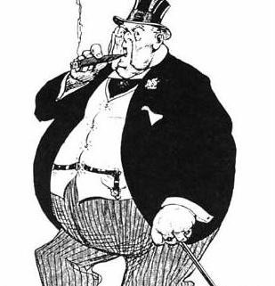
He continues with ‘And speed glum heroes up the line to death.’
Sassoon doesn’t believe in any glorified notion of Fate, in this poem; as far as he’s concerned, the majors are to blame for the death of the soldiers. They are no better than murderers and overgrown children playing at war – ‘puffy petulant face’ – while not quite aware of the huge sacrifices that involve the soldiers they are commanding.
Note that while the war is going on, the Major is ‘guzzling and gulping in the best hotel’, usually miles away from the Front, unaware of the true nature of the war so long as they were set there in command.
This Photo by Unknown Author is licensed under CC BY-SA

Slide 6
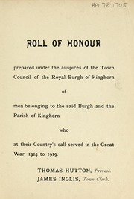
The ‘Roll of Honour’ was a list of names of the people who died while performing military service. The Roll of Honour, in this poem, takes on a manner much like a piece of engrossing fiction – their only comment to the names on the list is ‘poor chap’, and a realization that they knew him.
Sassoon dehumanizes his soldiers through the reaction of the army to their dead. There is no emotion in Base Details – and through that lack of emotion, he shows how callously the Majors and the Generals and the higher ranking men treated the privates and the soldiers.
Even the use of the word ‘scrap’ – when put into the context of a battle such as the Somme, or Ypres – shows a ridiculous lack of respect for human life.
This Photo by Unknown Author is licensed under CC BY-SA-NC

Slide 7
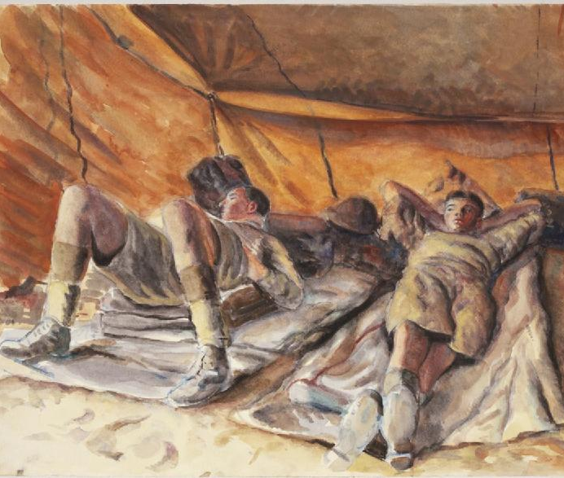
At the end, Sassoon bitterly describes how his soldier toddles on home – as unaffected by the war at its end as he was at the start – only to die in bed. The finality of the last line – ‘I’d toddle safely home—and die’ is shocking when compared to the rest of Base Details.
It is such a selfish, sharp poem; such a bitter expression of human misery, hidden within the complete lack of emotion given to the combination of the higher ranks.
This Photo by Unknown Author is licensed under CC BY-SA

Slide 8
Satire
This is a satirical poem.
Satire is the use of humour, irony, exaggeration, or ridicule to expose and criticize people's stupidity or vices, particularly in the context of contemporary politics and other topical issues.
In this poem the Major is being ridiculed.
This Photo by Unknown Author is licensed under CC BY-SA

Slide 9
Theme and Tone
The theme is war. ‘And youth stone dead’
The overall tone is negative. ‘poor young chap’.

