Slide 1
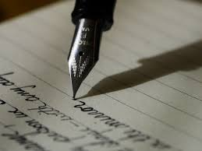
The Aesthetic Use of Language
Ms Deasy

Slide 2
What is meant by the Aesthetic Use of Language?
Students are expected to show an appreciation of how language can be used to create an aesthetic effect in writing, how language can be used to create concepts of beauty and harmony through the use of words that add up to striking images of things.
The emphasis here is on the use of language as an artistic or creative medium.

Slide 3
The Aesthetic use of Language
Creative/Original
Carefully Chosen words
Sensory Language
Artistically Pleasing
Rhythm (Musical/Sound Effects)
Descriptive
Metaphors/Similes
Imagery
Other poetic techniques

Slide 4
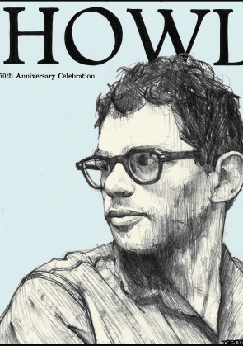
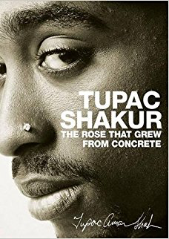
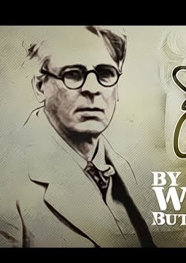
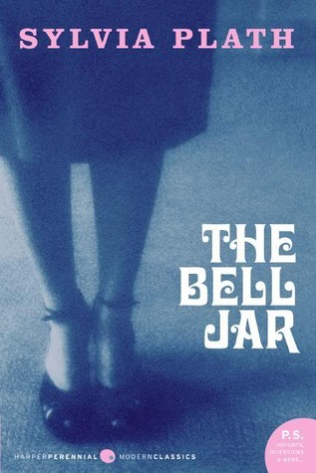
Where do we see it?
Poems
Novels
Shakespeare
Embedded in various texts

Slide 5
James Joyce – The Dead
A few light taps upon the pane made him turn to the window. It had begun to snow again. He watched sleepily the flakes, silver and dark, falling obliquely against the lamplight. The time had come for him to set out on his journey westward. Yes, the newspapers were right: snow was general all over Ireland. It was falling on every part of the dark central plain, on the treeless hills, falling softly upon the Bog of Allen and, farther westward, softly falling into the dark mutinous Shannon waves. It was falling, too, upon every part of the lonely churchyard on the hill where Michael Furey lay buried. It lay thickly drifted on the crooked crosses and headstones, on the spears of the little gate, on the barren thorns. His soul swooned slowly as he heard the snow falling faintly through the universe and faintly falling, like the descent of their last end, upon all the living and the dead.

Slide 6
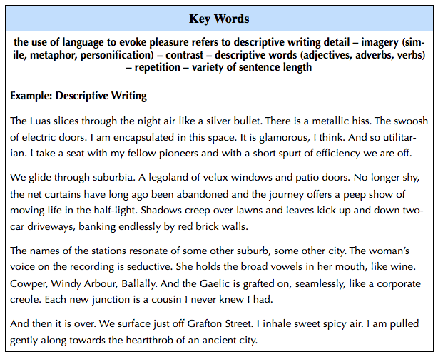

Slide 7
Sample
Listen to the following poem recital from Sarah Kay and discuss why it might be considered aesthetic!
https://youtu.be/6GqMgLnluKY

Slide 8
My Favourite Things
My hobby is to draw and sketch. Different scenes dance in my thoughts, and I think of what to draw next. My pencil runs down the paper, swaying this way and that. Lightly touching the page, or stabbing the lead into it instead. Then colors cross my mind. But instead I leave it plain. Making things fit together. Lines cross and loop. Eyes are glimmering as if she were actually standing in the light. But she’s not. She is on a white sheet of paper, not quite finished, missing a body. Gray fire blazes across my paper, but doesn’t seem to burn it. My sketch of a person shows the feeling of evilness. And another next to it showing kindness and peace. They are opposites that look almost identical, but different colors. This just proves that sketching is my way of expressing and letting out my feelings on a small sheet of white paper.

Slide 9
Your turn…
Write one paragraph entitles “My Favourite Things”

