Slide 1
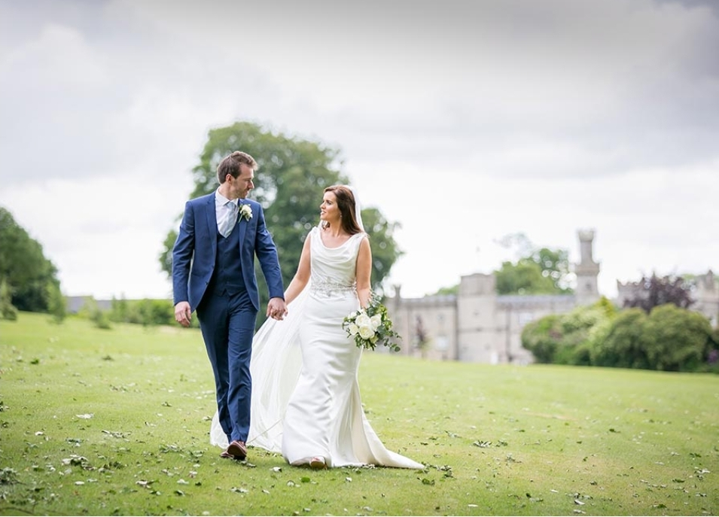
A Great Day
Brendan Kennelly

Slide 2
The theme of love is often a feature of Kennelly’s poetry but rarely does that theme represent itself as clearly as it does in this poem about a wedding day.
This free- verse poem combines single-line verses, couplets, tercets and quatrains.
Kennelly begins this love poem with “She was all in white,” and the chatty, amiable tone feels less like a poem and more like reported speech.

Slide 3
The poet assumes the role of narrator, and atypically (unusually), he omits the names of people and places.
However, this omission is understandable given the universality of the theme.
The verse continues “Snow / Suggests itself as a metaphor…” for the dress but “Something about snow is not quite right.”
This mischievous wordplay lightens the atmosphere of the poem; the poet is giving readers an insight into how he writes his work.
The groom is first shown to us “dickied up in dignified blue”.
Kennelly’s poems often contain a mix of colloquialism and alliteration.

Slide 4
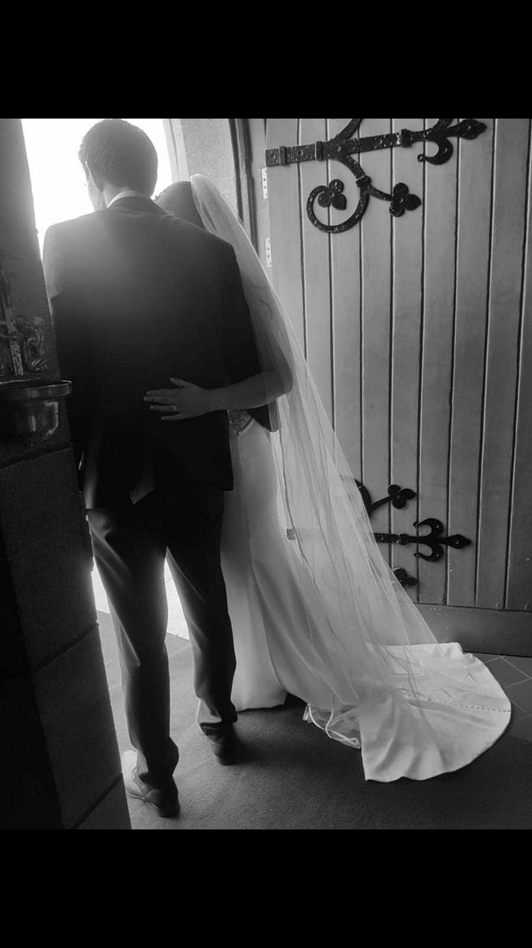
After the sixth verse the form of the poem changes.
The contained early verses are replaced by enjambment, suggesting excitement as the wedding ceremony begins.
“They came together… Through a grave ritual,” he writes before leading into a new verse where he explains the “wonder” of matrimony and hopes that “no man put asunder” the union.
Skilfully he uses palindrome (reads the same forwards and backwards) to suggest the balance of their love: “Man in woman, woman in man”.
There is a traditional feel to this church based ceremony between an man and a woman; typical of the 1990s Ireland in which it was written.

Slide 5
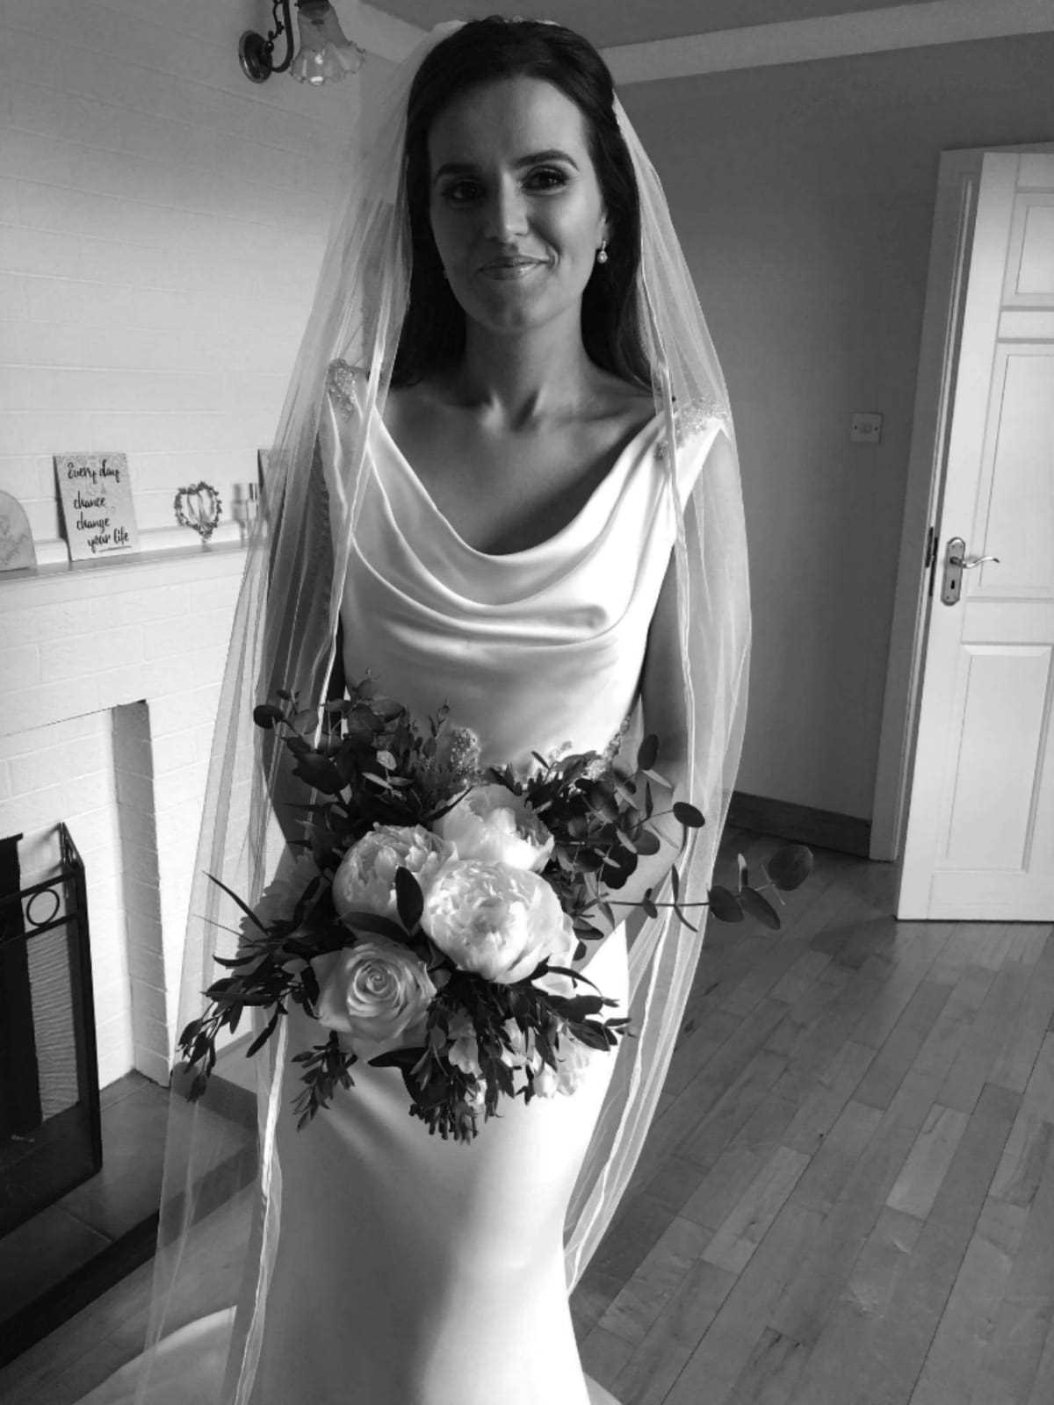
The title reappears in the middle third of the poem – offering coherence and reinforcing the poem’s sense of revelry.
Kennelly descries a day of “Dionysiac festivity”, invoking Dionysus, the Greek god of wine and fertility.
He creates a joyous atmosphere where guests shared “wine” and “praises” to the point where they saw “each other in a new way”.
The opening line is paraphrased in the 12th verse while the next stanza repeats the description of the husband; our focus becomes the newlyweds once more.

Slide 6
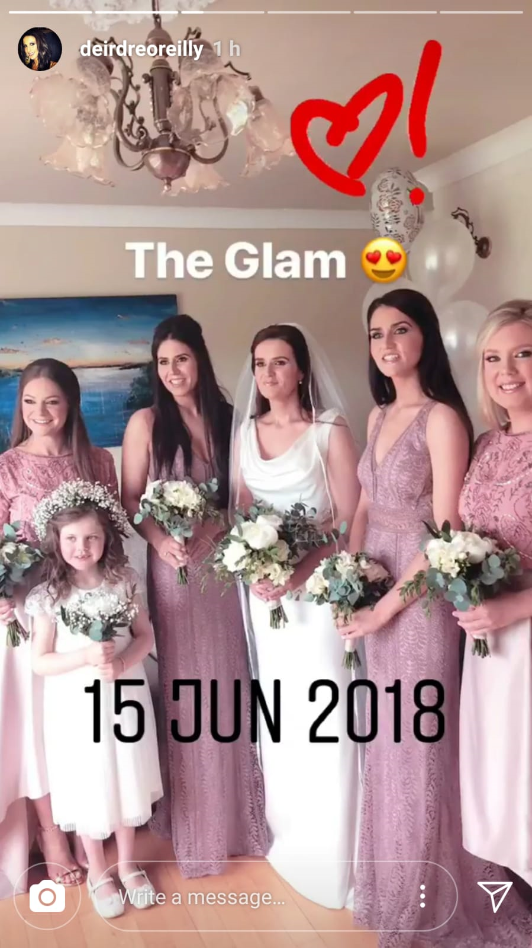
Simple rhymes (“white/bite”, “true/blue”) reiterate the light-hearted atmosphere.
I enjoyed Kennelly’s accessible, informal language, so common in his poetry and fitting for the relaxed occasion.
Balance and security are suggested when he writes: “At the table where they sat / Things seemed to fit”.
This unrhymed couplet offers us, and the newlyweds, some respite – though it doesn’t last long as the poet returns to describing, using assonance and repetition, the “loud crowd” which “sang and danced” for the “whole day”.

Slide 7
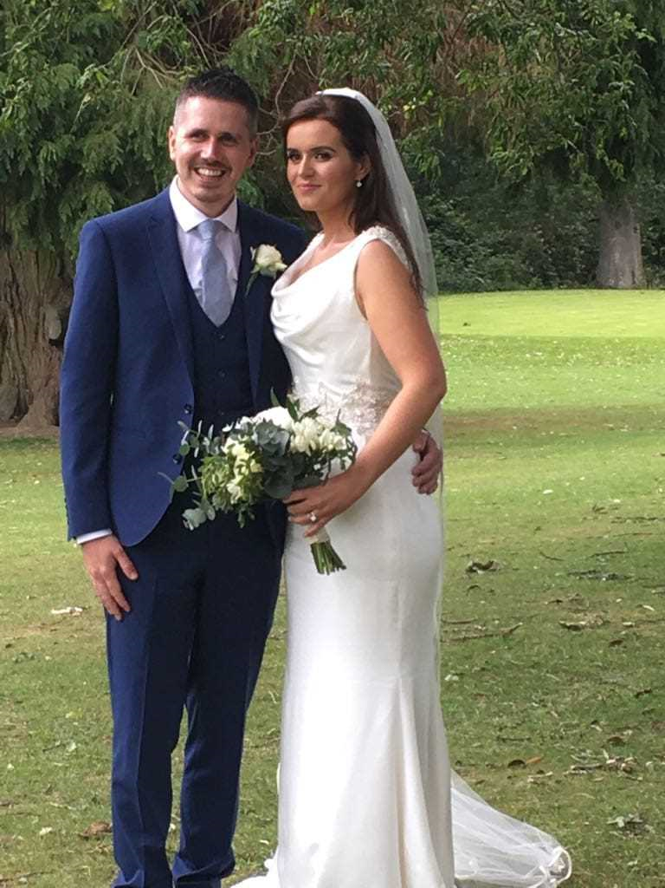
For all of their social graces, the poem closes with the couple seeking privacy.
Kennelly seems to turn down the volume of the party now. “I must change, she whispered,” and there is a poignancy to this quiet moment, emphasised when we read that her husband “never saw the white dress again”.
In one way, then, this is a poem about the wedding dress – its colour adds a touch of purity, its only outing captures the unique nature of the day, and its removal signals the end of the event and the beginning of an officially shared life.

Slide 8
They leave the ceremony but its undertones are all around them.
They take a train journey past trees that wore “rainy vails” and appeared as “silent guests”.
The privacy becomes more personal as the poet uses another metaphor to describe the “tide of thoughts” in the new bride’s mind, thoughts which are also “In his head.”

Slide 9
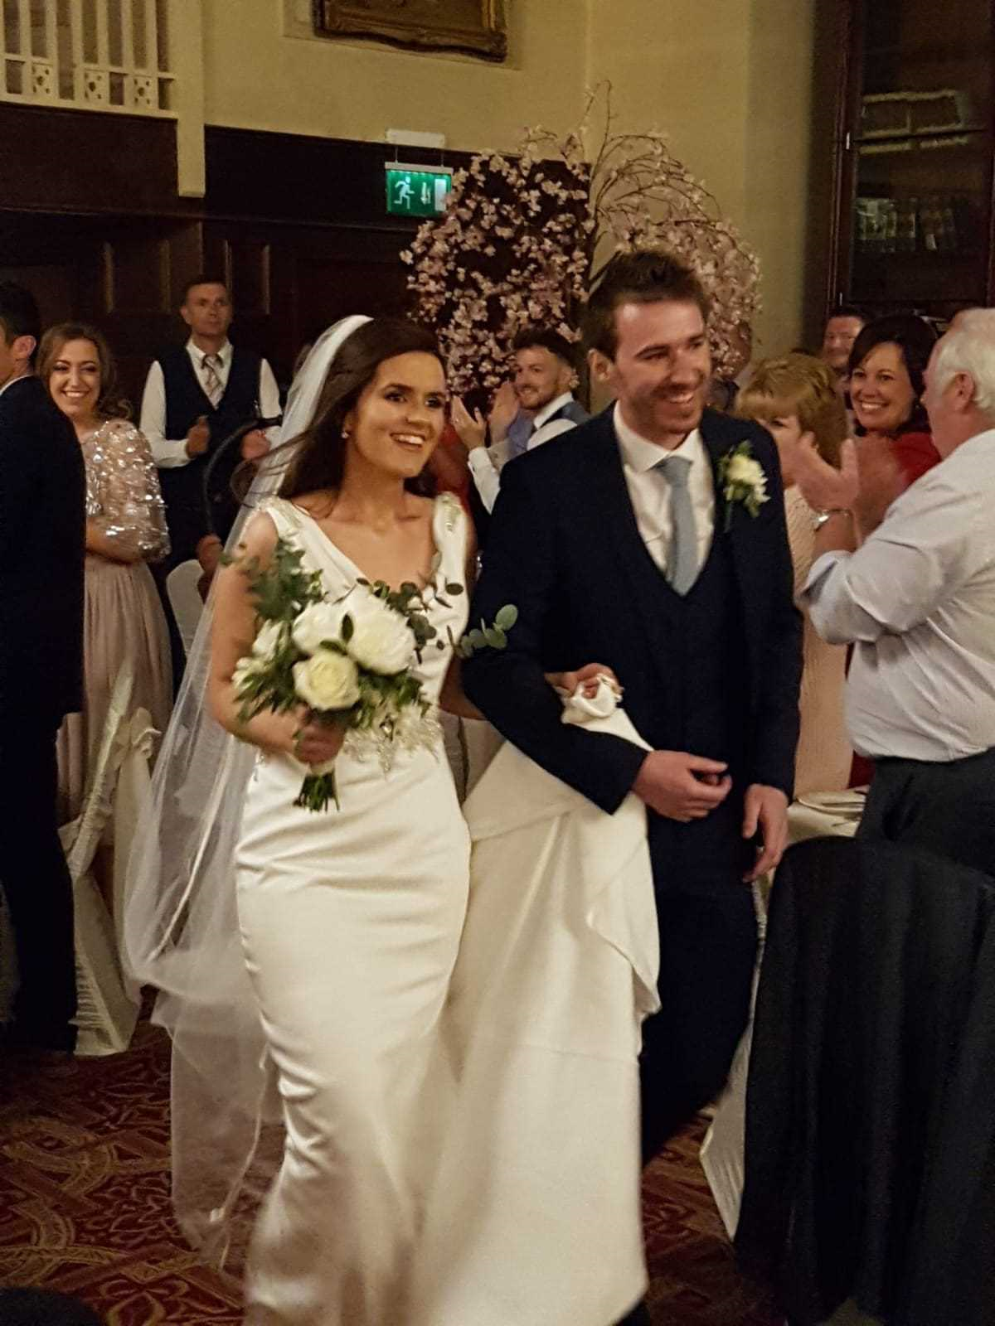
Kennelly seems to be commenting that there remains something unknowable about even our most intimate partners.
Regardless, that feels like a thought for another time.
“Darling,” says the wife, “it was a great day.”
Kennelly commonly ends his poems with a reference to their titles; it brings both the poem and the occasion to a satisfying, graceful end.

