Slide 1
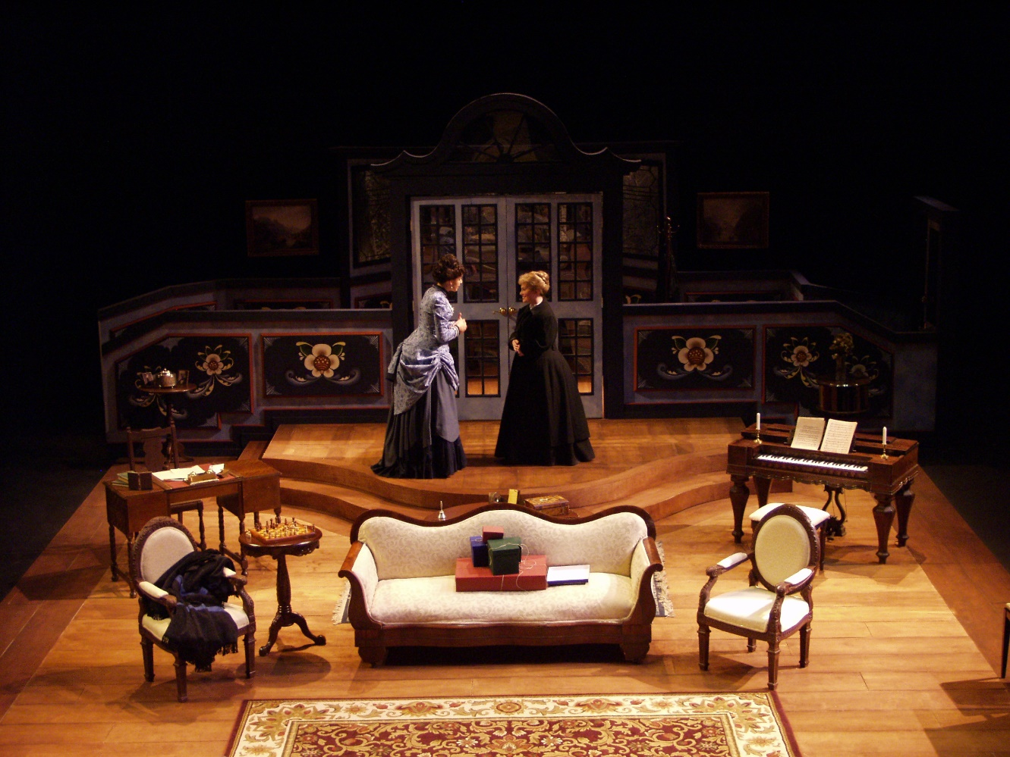
A Doll’s House
Henrik Ibsen
General Vision and Viewpoint

Slide 2
1. Beginning of ADH (Hope/Despair)
The drama begins with a bleak view of life as a gender hierarchy forces women into inferior positions, presenting a world where individuals are not judged according to their worth, performance, attributes or character, but rather perceived according to gender.
A depressing view of life is created as certain individuals are immediately forced into constrained existences due to a factor beyond their control.
This reinforces how such an existence cannot be escaped (at the beginning of the drama)

Slide 3
Nora introduces this with the secret loan she has attained to assist her husband in a time of need. According to the aforementioned culture of this world she should not do so, as a husband was expected to care for the family and not be dependent any other, especially his wife.
By taking the secret loan Nora has thus contravened societal conventions, and thus is in a place to challenge the culture of this place; however, she bleakly decides to hide her action, which shows recognition and acceptance of the culture that seeks to elevate men to a highstanding position in society.

Slide 4
Her decision to hide the loan, and thus retain her husband’s reputation, is thus bleak as she has the opportunity to oppose the world that downgrades her but fails to do so, implying a belief that she should not act inappropriately, thus revealing one reason for why the difficult
situation of women cannot be escaped from at present: “How painful and humiliating it would be for Torvald, with his manly independence, to know that he owed me anything!”

Slide 5
2. World of the text - is it conducive to a certain mindset, optimistic or pessimistic?
The aforementioned overbearing gender dichotomy causes females to presume their inferior positions should be accepted, and by the same token males believe in the worth of their superior roles.
The presentation of life is once more depressing as a result, as individuals judge others based on ultimately irrelevant factors, presenting a superficial world with a distorted ranking system that awards individuals with a warped mindset and punishes those who have done nothing to deserve this.

Slide 6
Such a muddled worldview is seen with Helmer, who treats his wife with disdain based purely on his belief of her inferiority due to gender. All aspects of their marriage are framed with this viewpoint, such as when he limits her spending due to his generalized belief that women cannot be trusted with money and should have their financial activity monitored: “That is like a woman… you know what I think about that. No debt, no borrowing.”
His comment is ironic as Nora’s financial affairs have recently benefited him, and such mistaken ignorance merely reinforces his warped mindset that wrongly judges his wife in such a generalized manner.

Slide 7
3. How individuals respond to such a world
As said, those who are oppressed in the world of the text, namely the female community, accept their lot and are unwilling to challenge the opposite sex and overriding culture of this space.
This creates a dark viewpoint as individuals do not seek to overcome such wrongs but rather attempt to fashion an acceptable living experience within such an immoral framework, thus reinforcing a world where those in charge and with influence can act inappropriately without any threat to their position.

Slide 8
Nora represents this with her dreams, which are restricted to conform to the cultural demands of the world she inhabits.
She can imagine being saved but only by a member of the opposite sex, thus showing how she subscribes to the restrictions of her existence, even in a fantasy scenario: “Many a time I was at my wits’ end… I used to sit here and imagine that a rich old gentleman had fallen in love with me… that he had died; and that when his will was opened it contained… the instruction: “The lovely Mrs. Nora Helmer is to have all I possess paid over to her at once in cash.”
Her unwillingness to even consider alternatives to the way of life in a make-believe scenario reinforces how Helmer’s position of dominance will not be threatened for some time, especially not in reality.

Slide 9
4. Support of others (or lack thereof)
There is a distinct lack of support for others in the text, even amongst the male community who profit as a result of females being relegated to positions of inferiority, both in marriage and general.
The result is a dark outlook as we view a fragmented society where members are willing to turn on each other, reinforcing the depressing view of the world introduced by the initial gender divide, now worsening as members on the controlling side reject each other.

Slide 10
Nora suggests how Helmer’s professional role is determined by consideration of how others will view his decisions: “A barrister’s profession is such an uncertain thing, especially if he won’t undertake unsavoury cases; and naturally Torvald has never been willing to do that.”
The quote suggests her husband is aware that others will turn on him should he make a decision they do not approve of, reinforced later when Helmer admits this could very well occur if his co-workers believe him to be influenced by his wife: “Do you suppose I am going to make myself ridiculous before my whole staff, to let people think that I am a man to be swayed by all sorts of outside influence?”

Slide 11
His reasoning is due to the gender divide that leads to a societal belief that women should retain inferior positions, as Helmer believes he will be ridiculed and rejected by the patriarchy if he is shown to allow a woman to influence his viewpoint.

Slide 12
5. Relationships and their effect
Relationships in the text are not wholly loving, but rather circumstantial and brought about for reasons other than the search for emotional connection.
Individuals are shown to be willing to use unions with others to pursue other agendas; the outlook on life is generally bleak as the very basis of such bonds is for two individuals to want to spend time with each other, with the lack of this desire reinforcing the hollow nature of relationships in the drama.

Slide 13
Mrs. Linde is an emphatic example of this, introduced with the revelation of her marriage formation. She admits to Nora that she only married her husband due to financial constraints, as this would allow her to provide some level of comfort for the family she was in charge of: “My mother was alive then, and was bedridden and helpless, and I had to provide for my two younger brothers; so I did not think I was justified in refusing his offer.”

Slide 14
The quote indicates the relationship was not centered on or concerned with love in the slightest, which is bleakly echoed later when she seeks out another relationship with Krogstad near the end.
Her reasoning for this union is that both could escape loneliness as a result: “Nils, how would it be if we two shipwrecked people could join forces?… Two on the same piece of wreckage would stand a better chance than each of their own.”
Her view of relationship formation matches earlier in the drama, which indicates that relationships do not alter at the end: indeed, this is reinforced by Nora exiting her loveless marriage at the close.

Slide 15
6. Key Moment
The moment when Nora rejects her entire family so as to escape her husband can be seen to create a dark outlook on life, as it reveals how difficult and trying the protagonist’s situation has become. Such is the depth of the oppression experienced that Nora can only escape her confining position by removing herself from all aspects of life, which thus requires rejecting her children, suggesting true independence from a previous painful experience requires total severance from this life.

Slide 16
Helmer’s attempt to have his wife focus on the familial realm rather than the marital union can be seen as an exploitative attempt to retain control over his wife, thus confirming he has not changed his ways: “To part - to part from you! No, Nora, no; I can’t grasp the thought…. But can we not live here, as brother and sister?”
Such a suspect action can be seen to reinforce the need for Nora to escape this world, and as a result it is not wholly poignant that she leaves both her husband and children, as we realize that if Nora remains for the latter’s sake she will never truly enjoy independence from a partner who is still showing a desire for control and dominance in the household she inhabits: “You know very well that wouldn’t last long. Goodbye Torvald. No, I won’t go to the children. I know they are in better hands than mine. As I now am, I can be nothing to them.”

Slide 17
7. Resolution (close of text)
The close of the text creates an optimistic outlook, as Nora finally challenges her husband who has oppressed her for the entirety of her marriage.
She no longer hides her actions, desires and mindset in secret, as was the case earlier in the drama when she took the secret loan but refused to tell anyone - including her husband - about this, so as to preserve his reputation: in doing so she also ensured the patriarchal society she inhabited was was not challenged but reinforced.

Slide 18
Nora’s willingness to attack her husband is a polar opposite to earlier when she sought to ensure he retained his high-standing position in society.
Now she asserts her independence by ripping his character to shreds, calling him out as an overpowering and oppressive controller:
“When your terror was over - not for what threatened me, but for yourself - when there was nothing more to fear - then it seemed to you as though nothing had happened. I was your lark again, your doll, just as before - whom you would take twice as much care of in future, because she was so weak and fragile.”

Slide 19
Her doing so is symbolic, as it marks a reversal from earlier where Nora’s attempt to preserve her husband’s reputation relied on her acceptance of a lowly position: now roles are reversed, as the protagonist’s rise is dependent on Helmer’s decline.
He loses control over his wife, who rejects her familial duties to exert entire independence: “What do you consider my most sacred duties?… your duties to your husband your children… I have other duties just as sacred… Duties to myself.”

